Slide 1
Chapter 4
Week 03
SNMPv1 Network Management:
Organization and Information Models
Network Management: Principles and Practice
© Mani Subramanian 2010
*

Slide 2
Objectives
Chapter 4 SNMPv1 Network Management: Organization and Information Models
Student Manual
Chapter 4 All sections
IETF SNMP standard
History
RFC, STD, and FYI
Organization Model
2- and 3-tier models
Manager and agent
Management messages
Structure of management information, SMI
Object type and instance
Scalar and aggregate managed objects
Management information base, MIB
NMS physical and virtual databases
IETF MIB-2 standard
Network Management: Principles and Practice
© Mani Subramanian 2010
*

Slide 3
Form internet
SNMP, MIBs and OIDs—an Overview
SNMP is one of the most commonly used technologies when it comes to network monitoring. Unified Monitoring programs—like PRTG Network Monitor—use it. But how does SNMP work? What are MIBs and OIDs? Read this short introduction and make the first step into the world of SNMP!
SNMP Basics
SNMP stands for Simple Network Management Protocol and consists of three key components: managed devices, agents, and network-management systems (NMSs). A managed device is a node that has an SNMP agent and resides on a managed network. These devices can be routers and access servers, switches and bridges, hubs, computer hosts, or printers. An agent is a software module residing within a device. This agent translates information into a compatible format with SNMP. An NMS runs monitoring applications. They provide the bulk of processing and memory resources required for network management.
SNMP version 1 was the initial development of the SNMP protocol. A description can be found in Request for Comments (RFC) 1157 and it works within the specification of the Structure of Management Information (SMI). It operates over User Datagram Protocol (UDP), Internet Protocol (IP), OSI Connectionless Network Services (CLNS), AppleTalk Datagram Delivery Protocol (DDP), and Novell Internet Packet Exchange (IPX). SNMP v1 is considered the de facto network management protocol in the Internet community.
SNMP—A Closer Look at MIBs and OIDs
MIB stands for Management Information Base and is a collection of information which is organized hierarchically. The various pieces of information are accessed by a protocol such as SNMP. There are two types of MIBs: scalar ones and tabular ones. Scalar objects define a single object instance whereas tabular objects define multiple related object instances grouped in MIB tables.
OIDs or Object Identifiers uniquely identify managed objects in an MIB hierarchy. It can be depicted as a tree whose nodes are assigned by different organizations. Generally, an OID is a long sequence of numbers, coding the nodes, separated by dots. Top level MIB object IDs (OIDs) belong to different standard organizations. Vendors define private branches including managed objects for their own products.
SNMP basically works with the principle that network management systems send out a request and the managed devices return a response. This is implemented using one of the following four operations: Get, GetNext, Set, and Trap. SNMP messages consist of a header and a PDU (Protocol Data Unit). The headers consist of the SNMP version number and the community name. The community name is used as a sort of password to increase security in SNMP. The PDU depends on the type of message that is sent. The Get, GetNext, and Set, as well as the response PDU, consist of PDU type, Request ID, Error status, Error index and Object/Variable fields. The Trap consists of Enterprise, Agent, Agent address, Generic trap type, Specific trap code, Timestamp and Object/Value fields.
MIBs, OIDs and Examples
MIBs are collections of definitions which define the properties of the managed object within the device to be managed. For example, the typical objects to monitor on a printer are the different cartridge states and maybe the number of printed files, and on a switch the typical objects of interest are the incoming and outgoing traffic as well as the rate of package loss or the number of packets addressed to a broadcast address. Every managed device keeps a database of values for each of the definitions written in the MIB. So, the available data is actually not dependent on the database, but on the implementation. Each vendor of SNMP equipment has their own section of the MIB tree structure at their disposition.
To organize all of these properly, all the manageable features of all products (from each vendor) are arranged in this MIB tree structure. Each 'branch' of this tree has a number and a name, and the complete path from the top of the tree down to the point of interest forms the name of that point. This complete path is the OID, the "identifier of an object" respectively. Nodes near the top of the tree are of an extremely general nature. For example, to get to the Internet, you need to reach the fourth node of the OID you can see below. When you move further down the tree, or further to the right respectively, the names get more and more specific, until you get to the bottom, where each node represents a particular feature on a specific device (or agent).

Slide 4
introduction
SNMP management is also referred to as Internet management.
Any network that uses TCP/IP protocol suite is an ideal candidate for SNMP management. SNMP network management systems (NMSs) can manage even non-TCP/IP network elements through proxy agents.
Most network components that are used in enterprise network systems have network agents built in them that can respond to an SNMP NMS. Thus, if a new component, such as a host, a bridge, or a router that has an SNMP agent built in, is added to a managed network, the NMS can automatically start monitoring the added component.
SNMP management got started as an interim set of specifications, the ultimate standard being OSI management. Since that did not materialize, SNMP specifications were enhanced by the development of SNMPv2 and SNMPv3. The first version of SNMP is informally referred to as SNMPvl, as it is titled in this chapter. SNMPv2 and SNMPv3 are covered in Chapters 6 and 7, respectively.
The Internet Engineering Task Force (IETF) has the responsibility to develop Internet standards including network management standards.
The SNMP management model is introduced in Section 4.4 and addresses primarily organization, information, and communication.
An NMS comprises management process, agent process, and network elements.

Slide 5
Chapter 4 SNMPv1 Network Management: Organization and Information Models
Case Histories, various corporations and institutions manage their networks
AT&T Network Management Centers
Network Control Centers
Network Operations Center
CNN World Headquarters
Centralized troubleshooting of NIC
Performance degradation due to NMS
Bell Operating company procedure
Notes
the power of technology could result in both positive and negative results.
An NMS is a powerful tool, but it could also bring your network down, when not "managed" properly.
we made several visits to see how various corporations and institutions manage their networks:
One of the visits was to an AT&T Network Control Center, which monitored the network status of their network in the entire eastern half of the United States. We could see the network of nodes and links on a very large screen, mostly in green indicating that the network was functioning well. The display screen would automatically refresh every few minutes. We saw nodes or links change color to yellow or red, indicating a minor or major alarm. We would also then see them turn back to green without interference by any human being. What we were seeing was monitoring of a national network from a central monitoring center. Monitoring was done by the NMSs and operations support systems without any human intervention. Even the healing of the network after a failure was accomplished automatically — self-healing network as it is called. Any persistent alarm was pursued by the control center, which tested the network remotely using management tools to isolate and localize the trouble. It was an impressive display of network management capability.
Network Management: Principles and Practice
© Mani Subramanian 2010
*

Slide 6
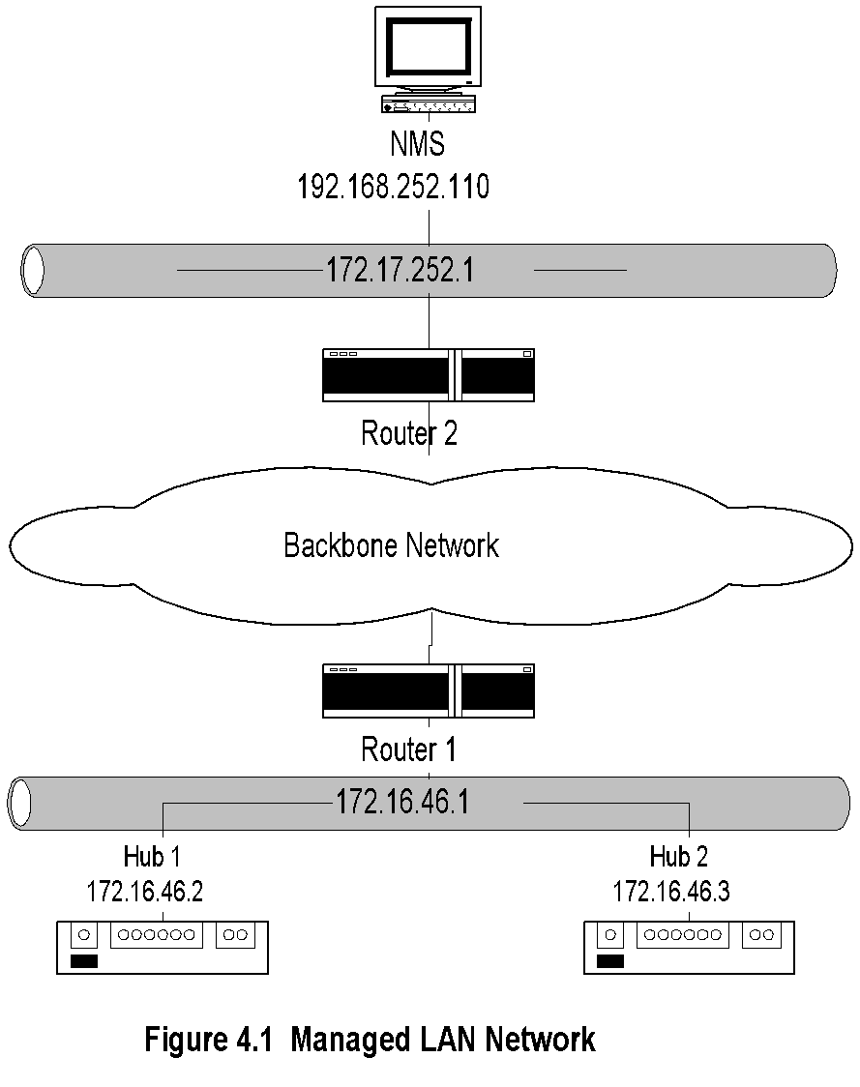
Chapter 4 SNMPv1 Network Management: Organization and Information Models
Managed LAN
Let us now illustrate what an NMS could do by monitoring a subnetwork using a commercial NMS. The addresses of network components have been intentionally modified for security reasons. Figure4. 1 shows a managed LAN that was discovered by an NMS. We show here only a subnetwork of a larger network managed by the NMS.As we mentioned above, an NMS can automatically discover any component in the network as long as the component has a management agent.
The managed subnetwork that we are discussing here is an Ethernet LAN that is shown below the backbone cloud in Figure 4. 1 . It consists of a router and two hubs and is connected to the backbone network. The LAN IP address is 172.16.46.1, and the two hub addresses have been configured as 172.16.46.2 and 172.16.46.3. The LAN IP address, 172.16.46.1, is the address assigned to the interface card in the router. Interface cards in the router and the interface card in each of the hubs are connected by a cat-5 cable forming the Ethernet LAN.
The NMS, whose IP address is 192.168.252.1 10, is physically and logically located remotely from the 172.16.46.1 LAN. It is configured on the LAN 192.168.252.1 and is connected to the backbone network. Information system managers establish conventions to designate a network and a subnetwork.
A 0 in the fourth decimal position of an IP address designates a network, and a subnetwork is designated with a 1 in the fourth position of the dotted decimal notation. Thus, 172.16.46.1 is a LAN subnetwork in the network 172.16.46.0.
Notes
NMS on subnet 192.168.252.1 manages the router and the hubs on subnet 172.16.46.1 across the backbone network

Slide 7
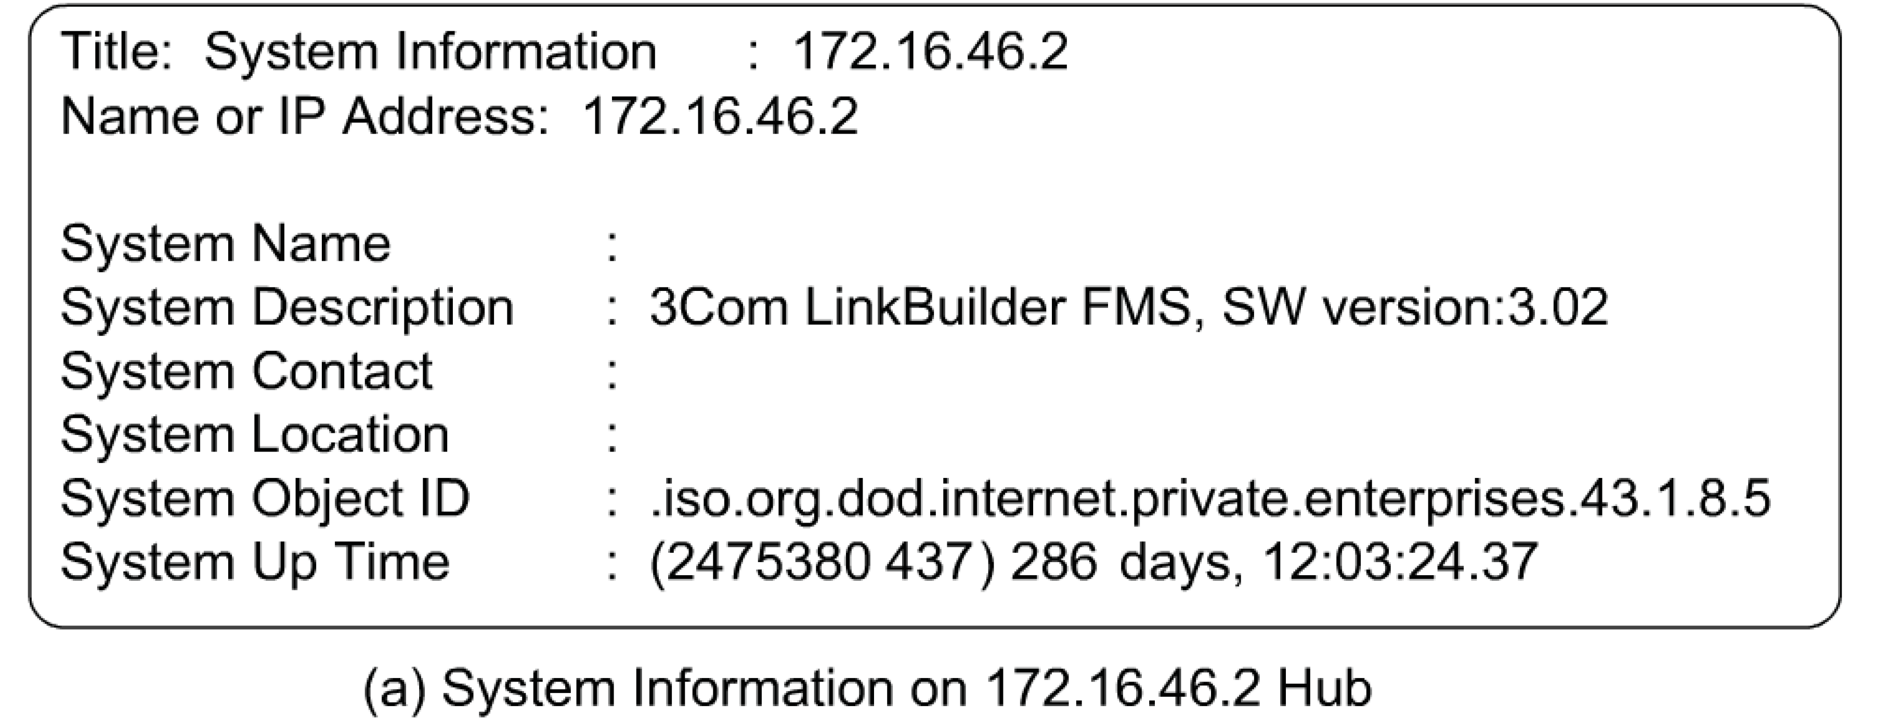
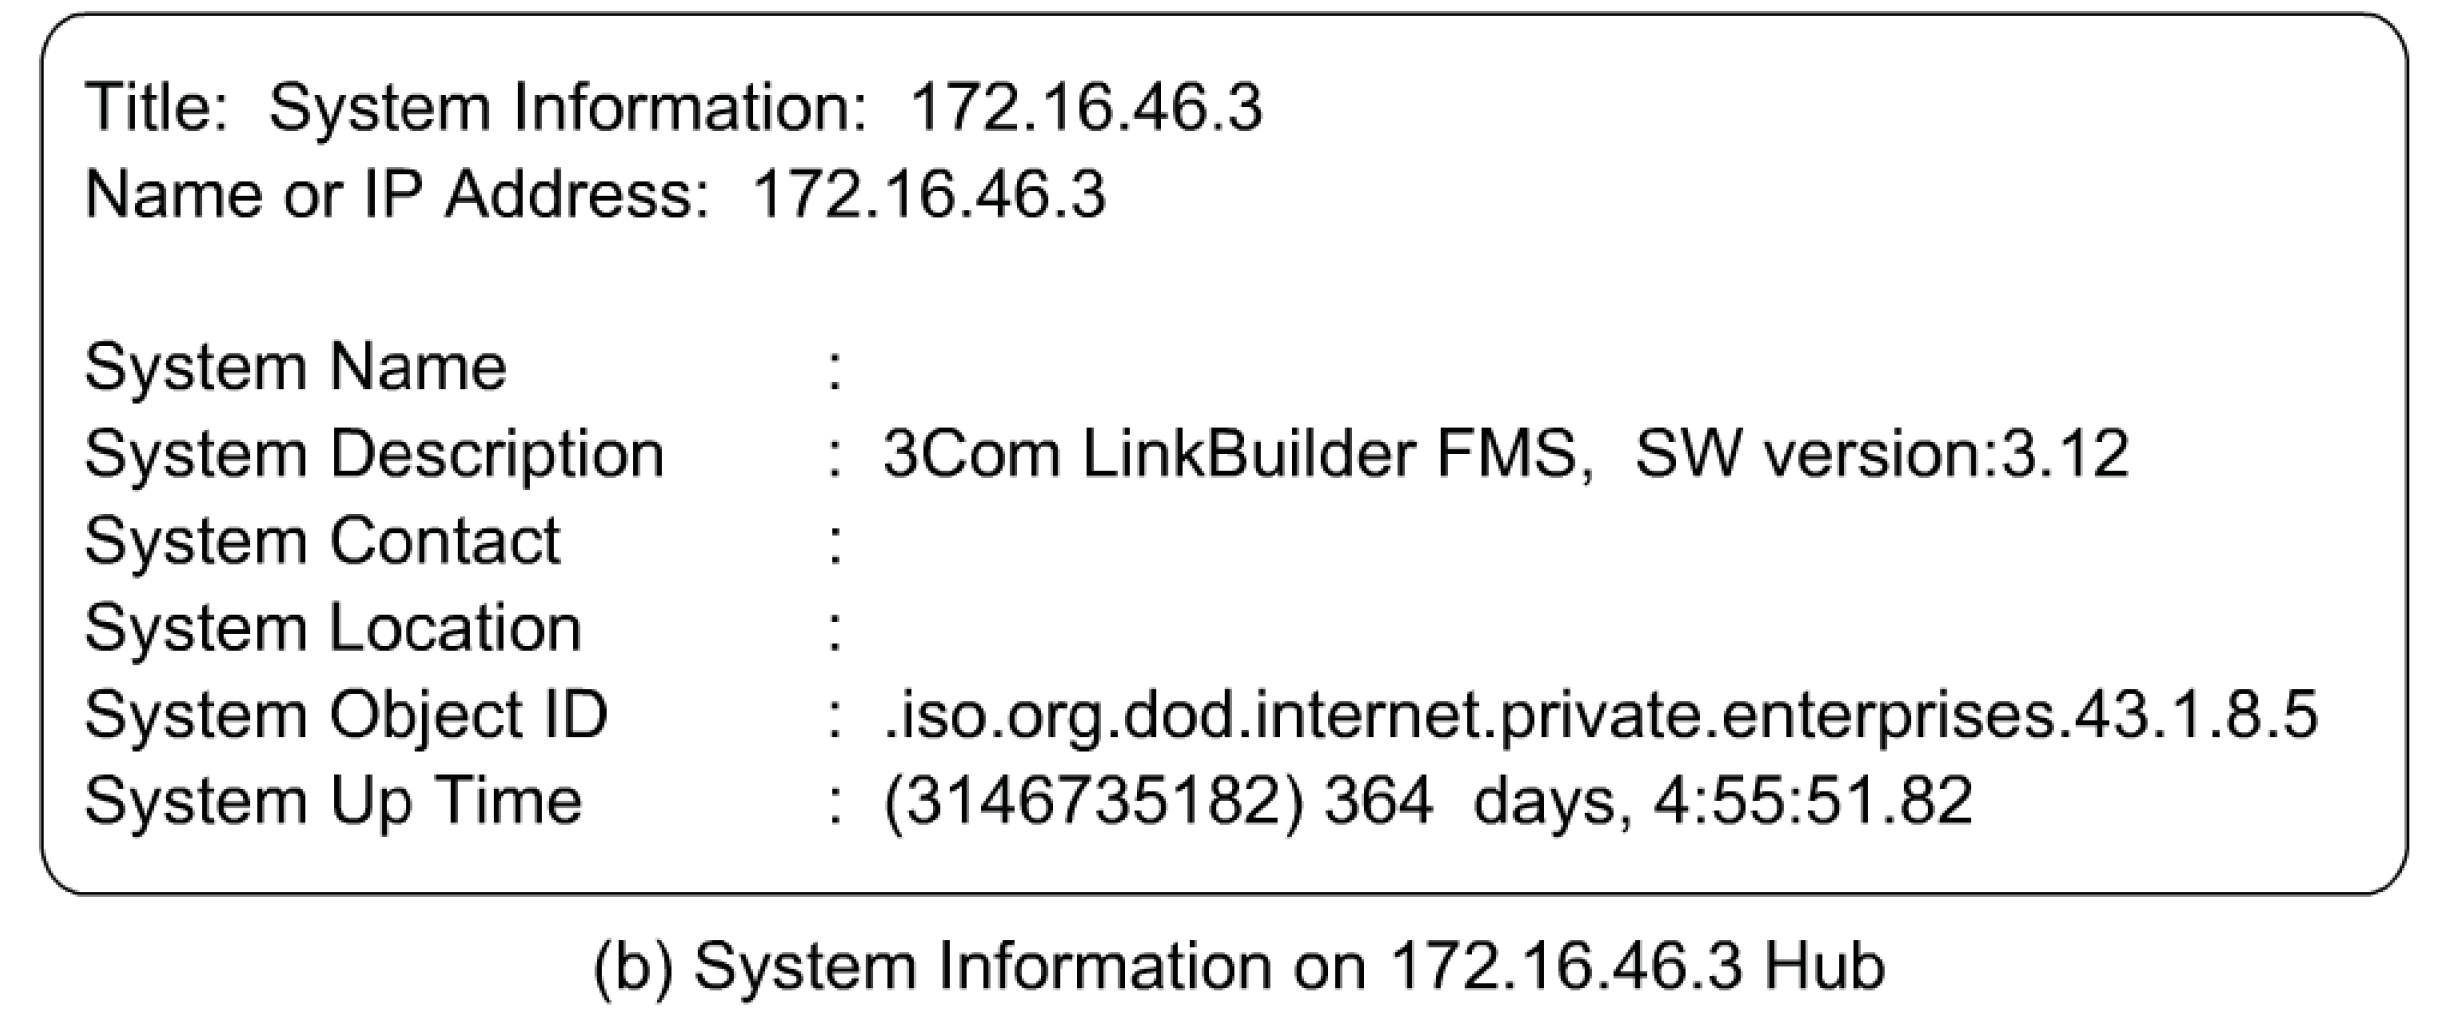
Chapter 4 SNMPv1 Network Management: Organization and Information Models
Managed Hub:
System Information
Once network components have been discovered and mapped by the NMS, we can query and acquire information on system parameters and statistics on the network elements.
Figure 4.2(a) shows that the network element is designated by 172.16.46.2. No specific title or name has been assigned to it. System description indicates that it is a hub made by a 3Com vendor, with its model and software version. It also gives the system object ID and how long the system has been up without failure. The format of the System ID follows the format shown in Figure 3.10 with the 3Com node under enterprises node being 43. The last three node numbers, 1.8.5, following 43 describe the private MIB of 3Com. The System Up Time indicates that the system has been operating without failure for over 286 days. The number in parenthesis is in units of one hundredths of a second. Thus, the hub designated by the IP address 172.16.46.2 has been up for 2,475,380,437 hundredths of seconds, or for 286 days, 12 hours, 3 minutes, 24.37 seconds. System Description and System Object ID are factory set and the rest are user settable.
Notes
Information obtained querying the hub
Data truly reflects what is stored in the hub

Slide 8
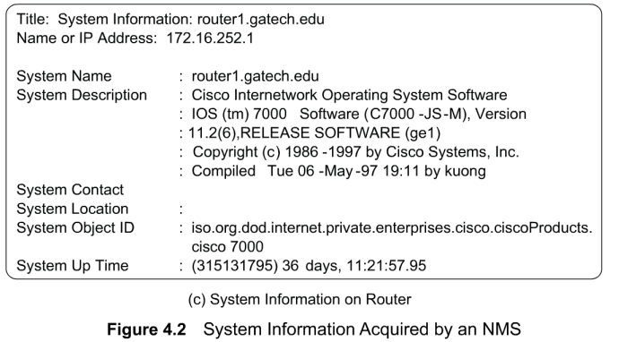
Chapter 4 SNMPv1 Network Management: Organization and Information Models
Managed Router:
System Information
Notes
Figure 4.2(c)
presents system information sent by the router on the network to the NMS's queries. The system name for the router has been configured and hence the query received the response of the name, router 1. gatech.edu.
Network Management: Principles and Practice
© Mani Subramanian 2010
*

Slide 9
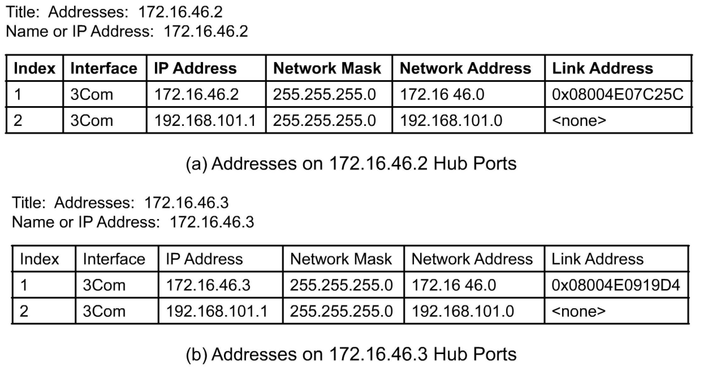
Chapter 4 SNMPv1 Network Management: Organization and Information Models
Managed Hub:
Port Addresses
Notes
Figures 4.3(a), (b), and (c) present the data acquired by the NMS from the interface cards on the two hubs and the router, which are on LAN 172.16.46.1. They are addresses associated with each interface. At the top of each figure are the titles and IP address or name of the network interface card used by the NMS to access the network component. Thus, in Figure 4.3(a), the title and the name or IP address are 172.16.46.2. Note that the IP address 172.16.46.3 is the address as seen by the NMS traversing the router.
By using a network lookup command, the IP address of routerl.gatech.edu can be recognized as 172.16.252.1.
Information acquired by the NMS on hub interfaces
Index refers to the interface on the hub
Link address is the MAC address
The second row data is a serial link

Slide 10
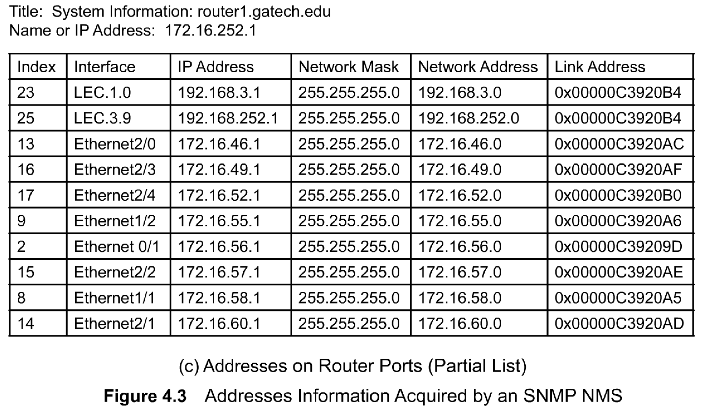
Chapter 4 SNMPv1 Network Management: Organization and Information Models
Managed Router:
Port Addresses
In Figures 4.3(a), (b), and (c), we notice that there are six columns of data. The first column is the index, which identifies the row in the matrix. Each row is a collection of various addresses associated with an interface. The second column describes the port id. For example, hubs 1 and 2 have 3Com cards in them. Column 2 of Figure 4.3(c) identifies the card and the port of the interface. For example, the row with index 2 identifies Ethernet 0 card/port 1. The IP address of the interface card is presented in the third column of the matrix.
The IP address in the third column and the network mask address in the fourth column are "and-ed" in modula-2 arithmetic to obtain the network address presented in the fifth column. This implies that all packets destined for network address 172.16.46.0 will be accepted by hub 1 .The sixth and the last column in Figure 4.3, the link address, contains the MAC address.
In the first row of Figure 4.3(a), 08004E07C25C is the MAC address of the hub 1 interface card. Link addresses in the second rows of Figures 4.3(a) and (b) are presented as "none," as they are non-LAN interfaces. The Figure 4.3(c) matrix has many rows, as it is a router with many interface cards, each with multiple ports. For example, each Ethernet card has four physical ports. LEC 1.0 and LEC 3.9 are ATM LAN Emulation Card interfaces.
Notes
Information acquired by NMS on the router interfaces
Index refers to the interface on the router
LEC is the LAN emulation card
Ethernet 2/0 interface refers to the interface card 2 and port 0 in that card

Slide 11
Chapter 4 SNMPv1 Network Management: Organization and Information Models
HISTORY OF SNMP Management
1970s Advanced Research Project Agency Network (ARPANET) Internet Control Message Protocol (ICMP)
Internet Engineering Task Force (IETF)
1990 SNMPv1
1995 SNMPv2
1998 SNMPv3
Internet documents:
Request for Comments (RFC)
IETF STD Internet Standard
FYI For Your Information
Source for RFCs
ftp://nic.mil/rfc
ftp://ftp.internic.net/rfc
http://nic/internet.net/
The Internet Network Information Center (TnterNIC) is an organization that maintains several archives that contain documents related to the Internet and the IETF activities. They include among other documents, Request for Comments document (RFC), Standard RFC (STD), and For Your Information RFC (FYI).
The Internet Assigned Numbers Authority (IANA) is the central coordinator for the assignment of unique parameter values for Internet protocols. It is the clearinghouse to assign and coordinate use of numerous Internet protocol parameters. The Internet protocol suite contains numerous parameters, such as Internet addresses, domain names, autonomous system numbers (used in some routing protocols), protocol numbers, port numbers, MIB object identifiers (including private enterprise numbers), and many others. The common use of Internet protocols by the Internet community requires that these values be assigned uniquely. It is the task of IANA to make those unique assignments as requested and to maintain a registry of currently assigned values.
Notes

Slide 12
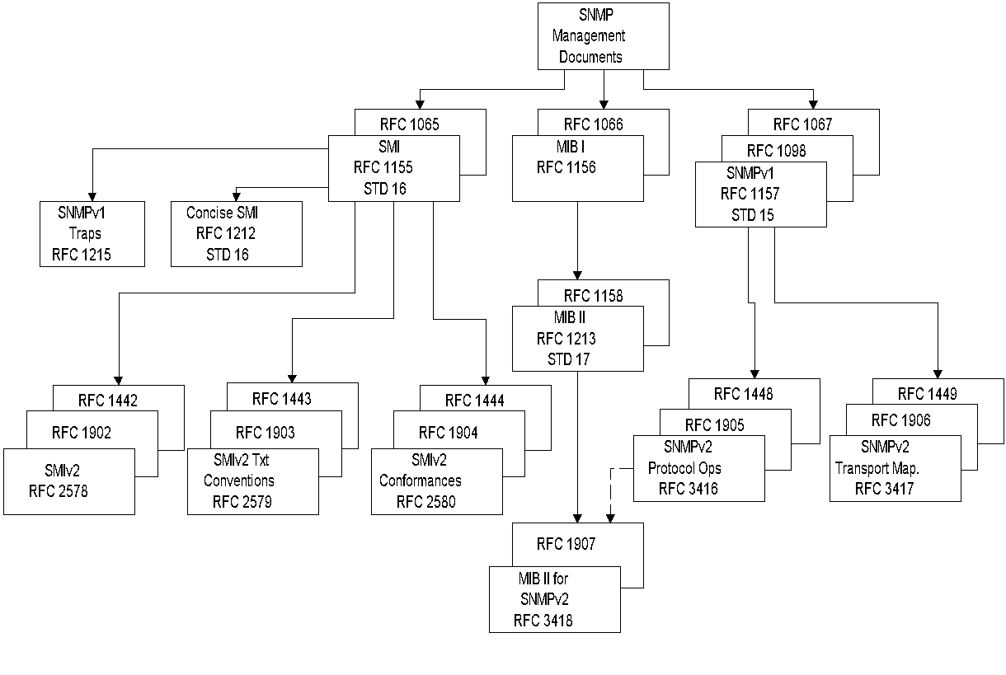
SNMPv1 & SNMPv2
Documents
Request for Comments
Early RFCs were messages between ARPANET architects about how to resolve certain problems. Over the years, RFC has become more formal. It had reached the point that they were being cited as standards. To help clear up some confusion, there are now two special subseries within the RFCs: FYIs and STDs.
FYIs. The "For Your Information" RFC subseries was created to document overviews and topics that are introductory.
The STD RFC subseries was created to identify those RFCs that do in fact specify Internet standards.
RFC documents are available in public libraries and can be accessed via the Internet
Figure 4.4 SNMP Document Evolution
Notes
There are three series of RFC and STD documents. They are: SMI, MIB, and SNMP Protocol.
Structure of Management Information (SMI) forms the contents of RFC 1155
MIB has gone through a few iterations. RFC 1213/STD 17 is the version that is currently in use.
SNMP protocol has gone through modification and is part of SNMPv2. RFC 1907

Slide 13
Originally, RFC was just what the name implies—Request for Comments. Early RFCs were messages
between ARPANET architects about how to resolve certain problems. Over the years, RFC has become
more formal. It had reached the point that they were being cited as standards, even when they were
not. To help clear up some confusion, there are now two special subseries within the RFCs: FYIs and
STDs. The "For Your Information" RFC subseries was created to document overviews and topics that
are introductory.
Frequently, FYIs are created by groups within the IETF User Services Area. The STD
RFC subseries was created to identify those RFCs that do in fact specify Internet standards. Every RFC,
including FYIs and STDs, has an RFC number by which they are indexed and can be retrieved. FYIs
and STDs have FYI numbers and STD numbers, respectively, in addition to RFC numbers. This makes
it easier for a new Internet user, for example, to find all of the helpful, informational documents by look¬
ing for the FYIs among all the RFCs. Ifan FYI or STD is revised, its RFC number will change, but its
FYI or STD number will remain constant for ease of reference.

Slide 14
4.4 SNMP Model
Organization Model
Relationship between network element, agent, and manager
Hierarchical architecture
Information Model
Uses ASN.1 syntax
SMI (Structure of Management Information)
MIB ( Management Information Base)
Communication Model
Transfer syntax
SNMP over TCP/IP
Communication services addressed by messages
Security framework community-based model
An NMS acquires a new network element through a management agent or monitors the ones it has acquired. There is a relationship between manager and agent. Since one manager is responsible for managing the designated functions of many agents, it is hierarchical in structure. The infrastructure of the manager-agent and the SNMP architecture that it is based on form the organization model. Information is transmitted and is received by both the manager and the agent. For example, when a new network element with a built-in management agent is added to the network, the discovery process in the network manager broadcasts queries and receives positive response from the added element.
The information must be interpreted both semantically and syntactically by the agent and the manager. We covered the syntax, ASN.l, in Section 3.7. Definition of semantics and syntax form the basis of the information model.
We present a detailed definition of a managed object, rules for the SMI, and a virtual information database MIB, which groups managed objects and provides a relational framework.
Communication between the manager and agents has to happen before information can be exchanged. The TCP/IP protocol suite is used for the transport mechanism. SNMP is defined for the application layer protocol and will be presented in Chapter 5.
Functions and services are not explicitly addressed in SNMP management. Security management is covered in the administration model as part of communication. Services are covered as part of SNMP operations.

Slide 15
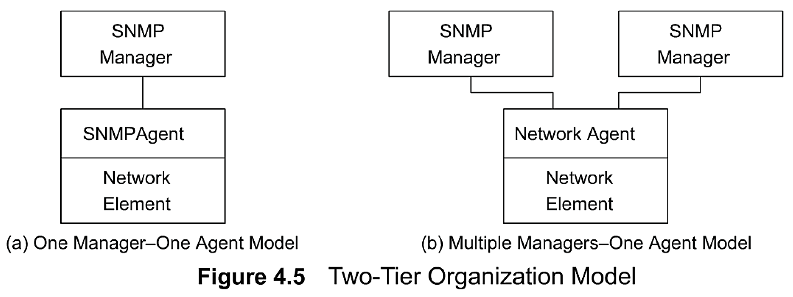
Chapter 4 SNMPv1 Network Management: Organization and Information Models
Two-Tier Organization Model
Notes
Any host that could query an agent is a manager.
The initial organization model of SNMP management is a simple two-tier model. It consists of a network agent process, which resides in the managed object, and a network manager process, which resides in the NMS and manages the managed object.
This is shown in Figure 4.5(a). Both the manager and the agent are software modules. The agent responds to any management system that communicates with it using SNMP. Thus, multiple managers can interact with one agent as shown in Figure 4.5(b) We can question the need of multiple managers in a system when it is easy to monitor all objects in a network with standard messages. However, to configure a system in detail, more intimate knowledge of the object is needed, and hence an NMS provided by the same vendor would have more capabilities than another vendor's NMS.
In two-tier models, the network manager receives raw data from agents and processes them. It is sometimes beneficial for the network manager to obtain pre-processed data. For example, we may want to look at traffic statistics, such as input and output packets per second, at an interface on a node as a function of time. Alternatively, we may want to get the temporal data of data traffic in a LAN.

Slide 16
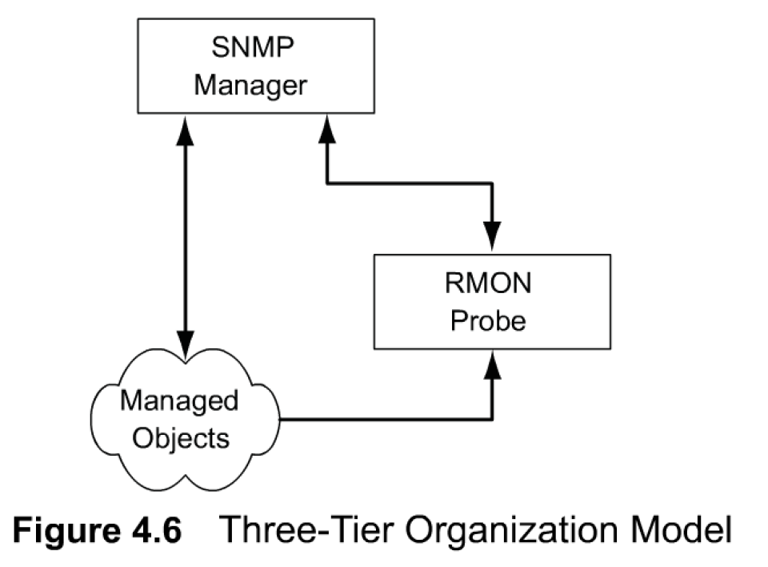
Three-Tier Organization Model:
RMON
Instead of the network manager continuously monitoring events and calculating the information —for example, data rate — an intermediate agent called Remote Monitoring (RMON) is inserted between the managed object and the network manager.
This introduces a three-tier architecture as shown in Figure 4.6. The network manager receives data from managed objects, as well as from the RMON agent about the managed objects.
The RMON function, implemented in a distributed fashion on the network, has greatly increased the centralized management of networks.
A pure SNMP management system consists of SNMP agents and SNMP managers. However, an SNMP manager can manage a network element, which does not have an SNMP agent. Figure 4.7 shows the organizational model for this case. This application occurs in many situations, such as legacy systems management, telecommunications management network, managing wireless networks, etc.
Notes
Managed object comprises network element and management agent
RMON acts as an agent and a manager
RMON (Remote Monitoring) gathers data from MO, analyses the data, and stores the data
Communicates the statistics to the manager

Slide 17
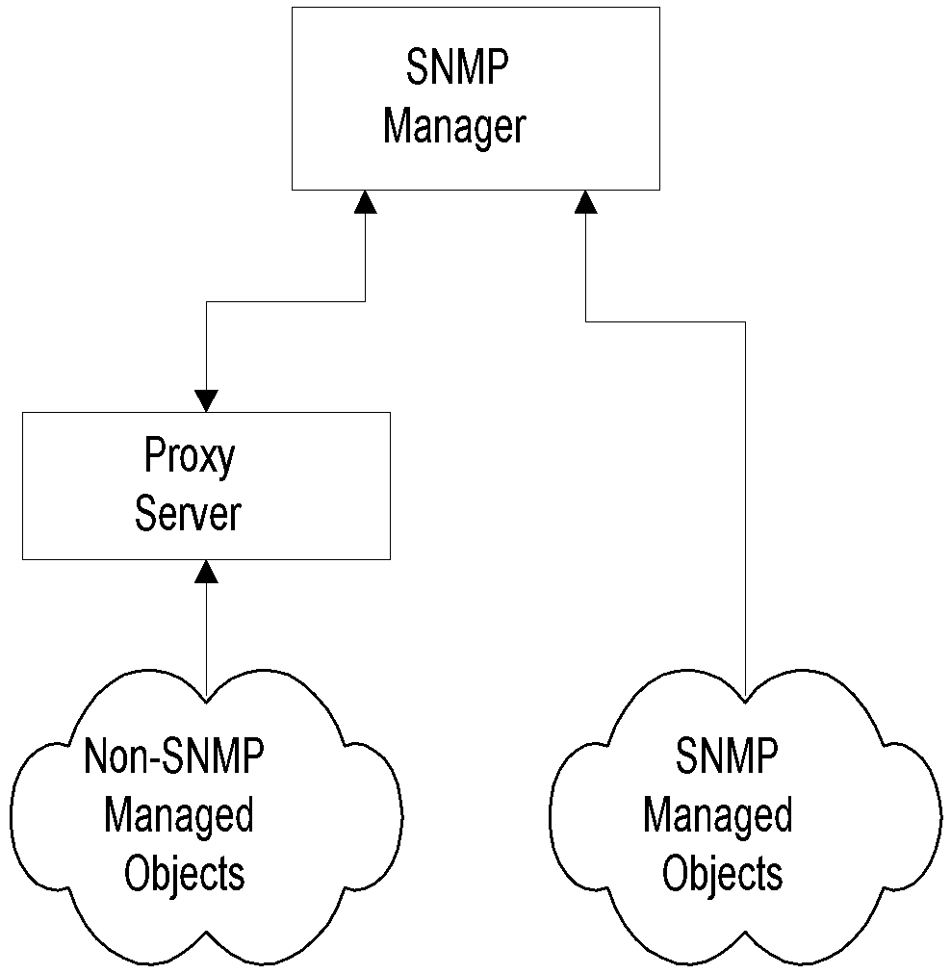
Chapter 4
Two-Tier Organization Model
Any host that could query an agent is a manager.
Three-Tier Organization Model: RMON
Managed object comprises network element and management agent
RMON acts as an agent and a manager
RMON (Remote Monitoring) gathers data from MO, analyses the data, and stores the data
Communicates the statistics to the manager
Three-Tier Organization Model: Proxy Server
Proxy server converts non-SNMP data from non-SNMP objects to SNMP compatible objects and messages

Slide 18
Chapter 4 SNMPv1 Network Management: Organization and Information Models
Three-Tier Organization Model:
Proxy Server
In all these cases, they are part of an overall network that have to be managed on an integrated basis. As an example in a legacy case.
We can have a proxy server at the central location that converts data into a set that is SNMP compatible and communicates with the SNMP manager.
An SNMP management system can behave as an agent as well as a manager. This is similar to client-server architecture, where a host can function as both a server and a client (see Figure 1.8).
In Figure 4.6, RMON, while collecting data from network objects, performs some functions (network monitoring) of a network manager. However, pre-processed data by RMON may be requested by the network manager or sent unsolicited by RMON to the network manager to integrate with the rest of the network data and to display it to the user.
In the latter situation, RMON acts as a network agent. Another example of a system acting as both an agent and a manager is when two NMSs managing two autonomous networks exchange information with each other when the networks are connected via a gateway.
This model is presented in Figure 4.8 and is applicable to two telecommunication service providers managing their respective wide area networks. To provide end-to-end service to customers, service providers may need to exchange management information between them.
Figure 4.7 Proxy Server Organization Model
Notes
Proxy server converts non-SNMP data from non-SNMP objects to SNMP compatible objects and messages

Slide 19
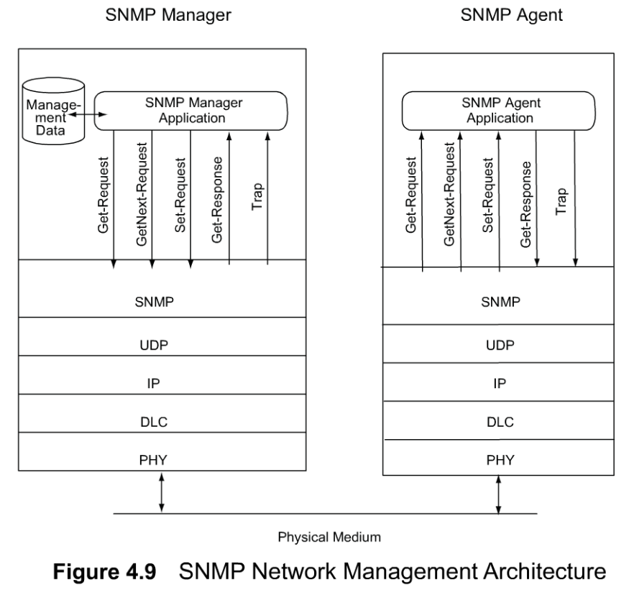
Chapter 4 SNMPv1 Network Management: Organization and Information Models
System Architecture
Notes
Messages between manager and agent
Direction of messages - 3 from manager and 2 from agent

Slide 20
System Architecture
The SNMP management from a system point of view. We have opted to do this prior to discussing details of the other three models— information, communication, and functional, because it would help us to understand them better if we have the big picture first.
Figure 4.9 shows SNMP network management architecture. It portrays the data path between the manager application process and the agent application process via the four transport function protocols: UDP, IP, Data Link Control (DLC), and Physical (PHY).
SNMP protocol has been intentionally designed to be simple and versatile متعدد الجوانب والاستعمالات
Communication of management information among management entities is realized through exchange of just five protocol messages:
Three of these (get-request, get-next-request, and set-request) are initiated by the manager application process.
The other two messages, get-response and trap, are generated by the agent process.
Message generation is called an event. In the SNMP management scheme, the manager monitors the network by polling the agents as to their status and characteristics. However, efficiency is increased by agents generating unsolicited alarm messages, i.e., traps.
The get-request message is generated by the management process requesting the value of an object. The value of an object is a scalar variable. System group parameters in Figure 4.2 are single-instance values and are obtained using the get-request message.
The get-next-request, or simply called get-next, is very similar to get-request. In many situations, an object may have multiple values because of multiple instances of the object.
The set-request is generated by the management process to initialize or reset the value of an object variable.

Slide 21
SNMPv1 network management architecture
the data path between the manager application process and the agent application process via the four transport function protocols: UDP, IP, Data Link Control (DLC), and Physical (PHY).
SNMP protocol has been intentionally designed to be simple and versatile متعدد الجوانب والاستعمالات
Communication of management information among management entities is realized through exchange of just five protocol messages:
Message generation is called an event. In the SNMP management scheme, the manager monitors the network by polling the agents as to their status and characteristics. However, efficiency is increased by agents generating unsolicited alarm messages, i.e., traps.
The get-request message is generated by the management process requesting the value of an object. The value of an object is a scalar variable.
The get-next-request, an object may have multiple values because of multiple instances of the object.
The set-request to initialize or reset the value of an object variable.
The get-response message is generated by an agent process. It is generated only on receipt of a get-request, get-next-request, or set-request message from a management process.
A trap is an unsolicited message generated by an agent process without any message or event arriving from the manager process. It occurs when it observes the occurrence of a preset parameter in the agent module. For example, a node can send traps when an interface link goes up or down.
The SNMP manager, has a database that polls managed objects for management data. It contains two sets of data — one on information about the objects (MIB), and a second on the values of the objects.
MIB is a virtual data (information) base and is static. If information about the managed object is not in the manager, it could still detect the object but would mark it as unidentifiable.
The second database is dynamic and contains measured values associated with the object. This is a true database. While MIB has a formalized structure, the database containing actual values can be implemented using any database architecture chosen by the implementers.
the SNMP manager has a database, which is the physical database, and the SNMP agent does not have a physical database. However, both have MIBs, which are compiled into the software module and are not shown in the figure.

Slide 22
System Architecture
The get-response message is generated by an agent process. It is generated only on receipt of a get-request, get-next-request, or set-request message from a management process. The get-response process involves filling the value of the requested object with any success or error message associated with the response.
A trap is an unsolicited message generated by an agent process without any message or event arriving from the manager process. It occurs when it observes the occurrence of a preset parameter in the agent module. For example, a node can send traps when an interface link goes up or down.
The SNMP manager, which resides in the NMS, has a database that polls managed objects for management data. It contains two sets of data —one on information about the objects (MIB), and a second on the values of the objects. These two are often confused with each other.
MIB is a virtual data (information) base and is static. In fact, it needs to be there when an NMS discovers a new object in the network. It is compiled in the manager during implementation.
If information about the managed object is not in the manager, it could still detect the object but would mark it as unidentifiable. This is because the discovery process involves a broadcast PING command by the NMS and responses to it from network components. Thus, a newly added network component would respond if it has a TCP/IP stack that normally has a built-in ICMP. However, the response contains only the IP address. MIB needs to be implemented in both the manager and the agent to acquire the rest of the information, such as the system group information shown in Figure 4.2.
The second database is dynamic and contains measured values associated with the object. This is a true database. While MIB has a formalized structure, the database containing actual values can be implemented using any database architecture chosen by the implementers.
It is worth noting in Figure 4.9 that the SNMP manager has a database, which is the physical database, and the SNMP agent does not have a physical database. However, both have MIBs, which are compiled into the software module and are not shown in the figure.

Slide 23
Assignment 1 Q3
Describe the System Architecture of SNMP Manager and SNMP Agent ?

Slide 24
Chapter 4 SNMPv1 Network Management: Organization and Information Models
SNMP Messages
Get-Request
Sent by manager requesting data from agent
Get-Next-Request
Sent by manager requesting data on the next MO to the one specified
Set-Request
Initializes or changes the value of network element
Get-Response
Agent responds with data for get and set requests from the manager
Trap
Alarm generated by an agent

Slide 25
Chapter 4 SNMPv1 Network Management: Organization and Information Models
4.7 INFORMATION MODEL
Structure of Management Information (SMI) (RFC 1155)
Managed Object
Scalar
Aggregate or tabular object
Management Information Base (RFC 1213)
For information to be exchanged intelligently between manager and agent processes, there has to be common understanding on both the syntax and semantics. The syntax used to describe management information is ASN.l . In this section, we will address SNMP-specific syntax and semantics of management information.
we will address the specification and organizational aspects of managed objects. This is called the Structure of Management Information (SMI).

Slide 26
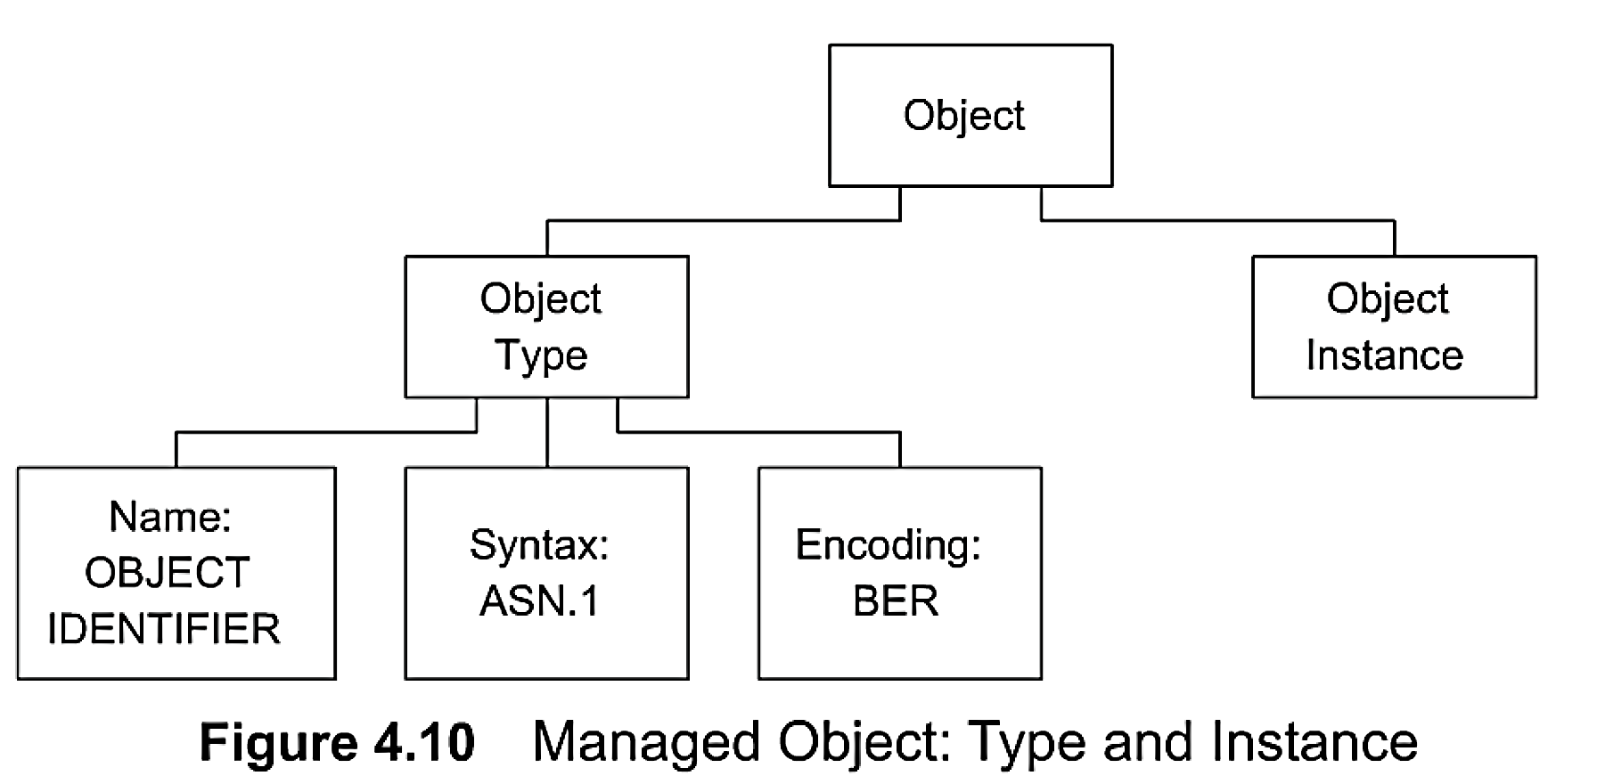
Chapter 4 SNMPv1 Network Management: Organization and Information Models
Managed Object
Notes
Object type and data type are synonymous
Object identifier is data type, not instance
Object instance IP address (See Figure 4.2)
Structure of Management Information (SMI)
A managed object can be considered to be composed of an object type and an object instance, SMI is concerned only with the object type and not the object instance.
The object type, which is a data type, has a name, a syntax, and an encoding scheme.
The name is represented uniquely by a descriptor and an object identifier.
The syntax of an object type is defined using the abstract data structure ASN.l
Basic encoding rules (BER) have been adopted as the encoding scheme for transfer of data types between agent and manager processes

Slide 27
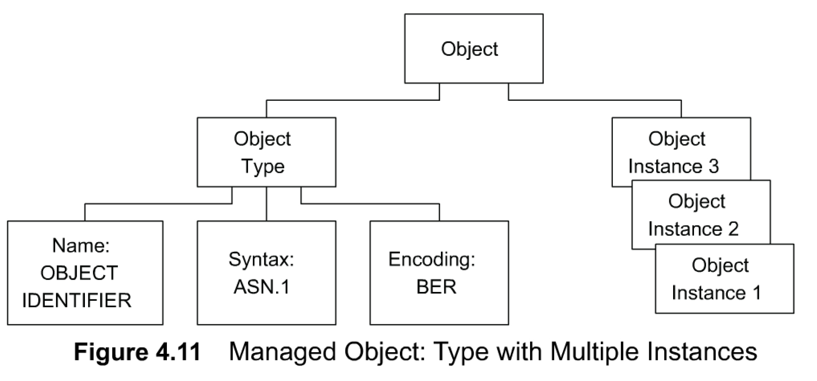
Chapter 4 SNMPv1 Network Management: Organization and Information Models
Managed Object: Multiple Instances
Notes
All 3 Com hubs of the same version have identical identifier; they are distinguished by the IP address.
Each IP address is an instance of the object.

Slide 28
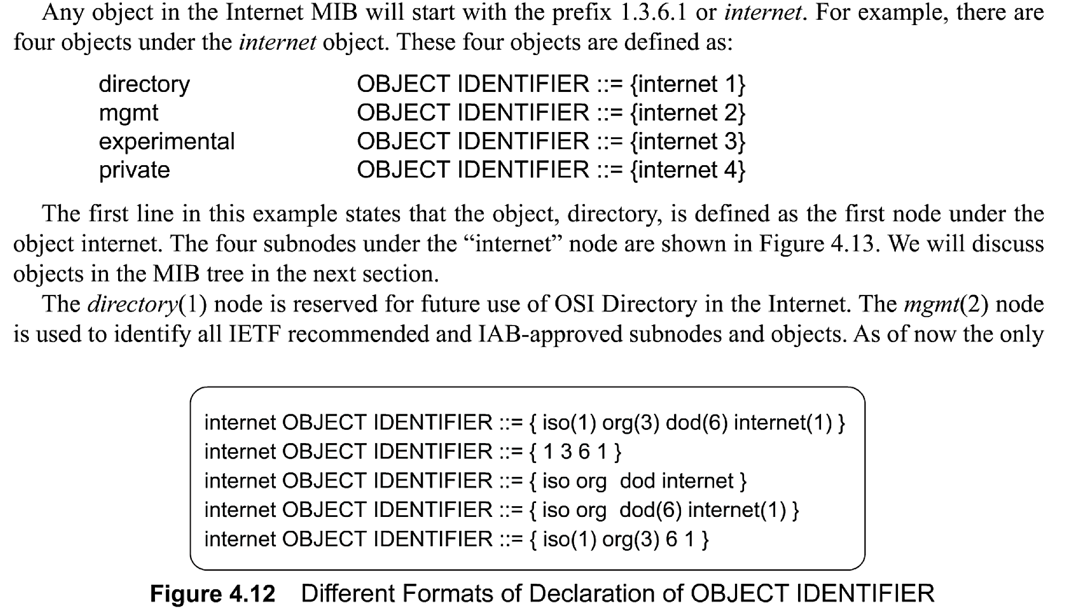
Chapter 4 SNMPv1 Network Management: Organization and Information Models
Name
Uniquely defined by
DESCRIPTOR AND
OBJECT IDENTIFIER
for exemple, internet OBJECT IDENTIFIER ::= {iso org(3) dod(6) 1 }.
Every object type, i.e., every name, is uniquely identified by a DESCRIPTOR and an associated OBJECT IDENTIFIER. DESCRIPTOR and OBJECT IDENTIFIER are in uppercase since they are ASN. 1 keywords. The DESCRIPTOR defining the name is mnemonic and is all in lowercase letters.

Slide 29
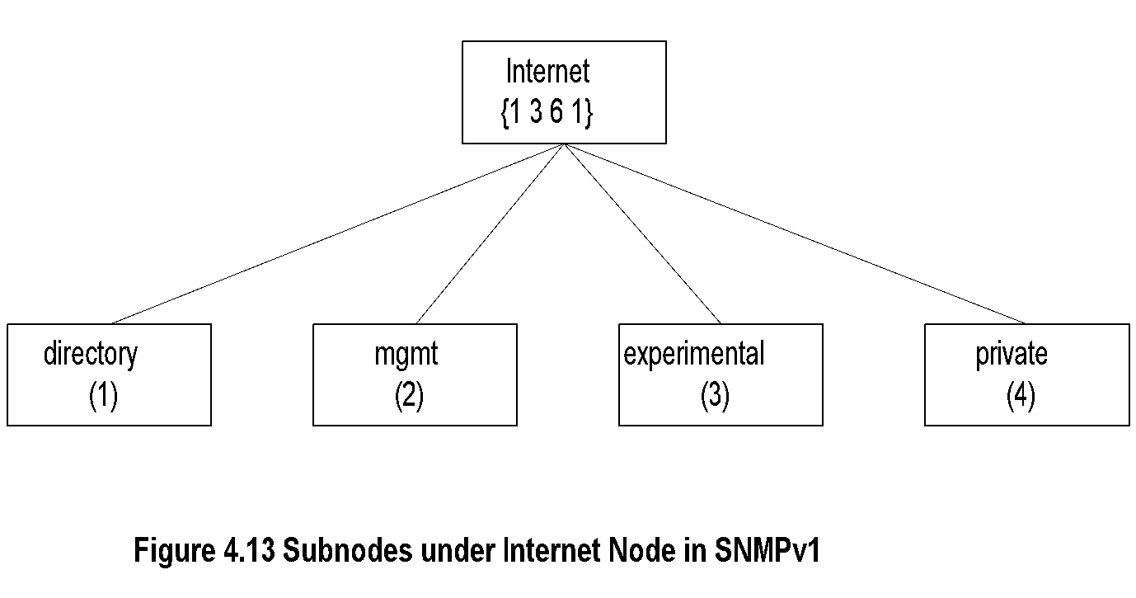
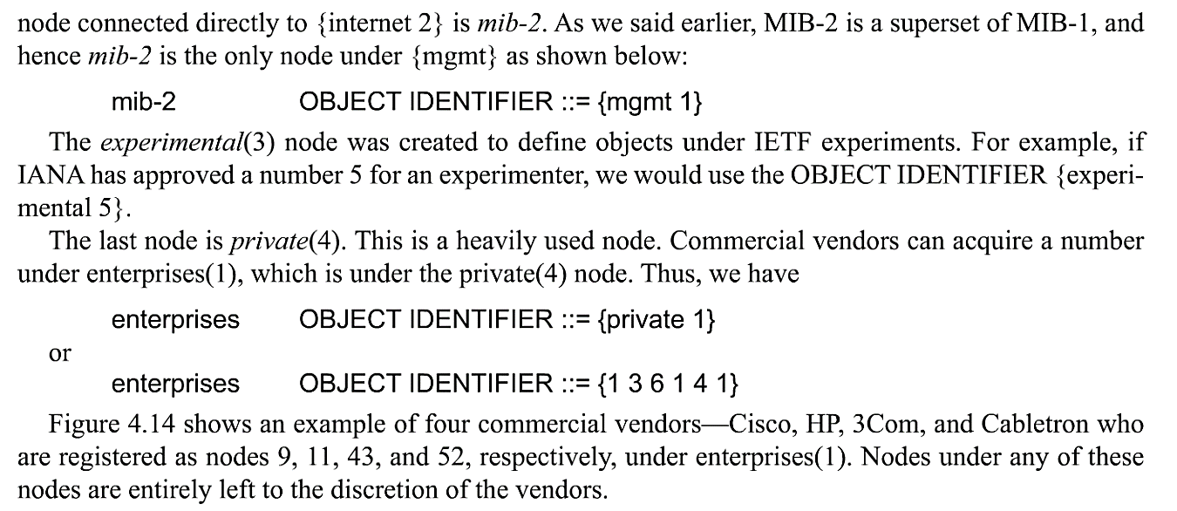
Chapter 4 SNMPv1 Network Management: Organization and Information Models
Internet Subnodes
Notes
directory OBJECT IDENTIFIER ::= {internet 1}
mgmt OBJECT IDENTIFIER ::= {internet 2}
experimental OBJECT IDENTIFIER ::= {internet 3}
private OBJECT IDENTIFIER ::= {internet 4}

Slide 30
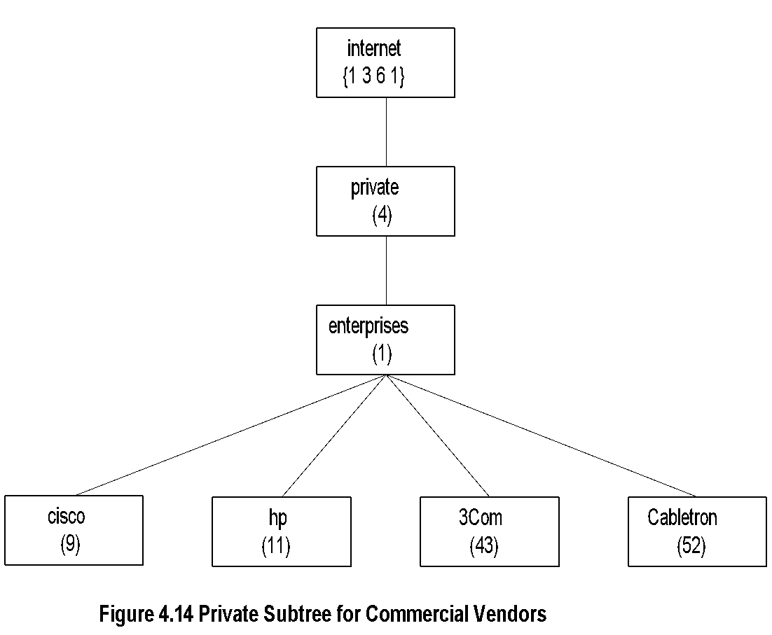
Chapter 4 SNMPv1 Network Management: Organization and Information Models
Private MIB Example
Notes
private MIB intended for vendor equipment
IANA (Internet Assigned Numbers Authority) assigns identifiers
Network Management: Principles and Practice
© Mani Subramanian 2010
*

Slide 31
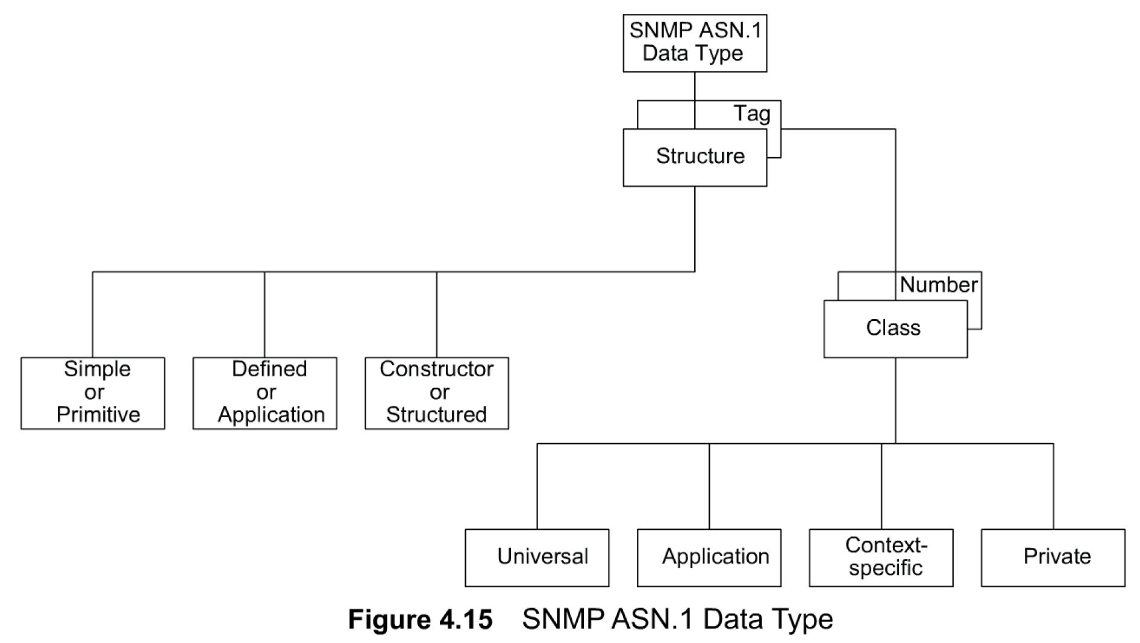
Chapter 4 SNMPv1 Network Management: Organization and Information Models
SNMP ASN.1 Data Type
ASN.1 syntax is used to define the structure of object types.
The three structural types shown in Figure 4. 1 5 are simple, constructor, and defined types. Other common terms used for these are primitive (or atomic), structured, and application types. The tagged type is not explicitly used in TCP/IP management,
SNMP ASN. 1 data types are listed in Table 4. 1.All data types except SEQUENCE and SEQUENCE OF are called base types. Primitive or simple types are atomic in nature and are: INTEGER, OCTET STRING, OBJECT IDENTIFIER, and NULL. These are also referred to as non-aggregate types.

Slide 32
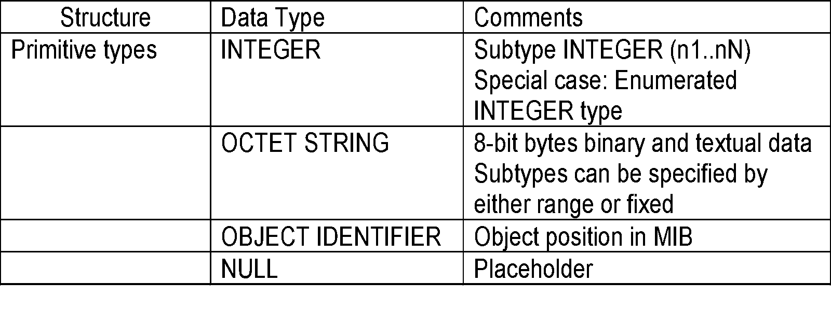
Chapter 4 SNMPv1 Network Management: Organization and Information Models
Primitive Data Types
Notes
get-request message has NULL for value fields and get-response from agent has the values filled in subtype:
INTEGER (0..255)
OCTET STRING (SIZE 0..255)
OCTET STRING (SIZE 8)
Any non-zero value indicates the type of error encountered by the agent in responding to a manager's message. As a convention, the value 0 is not permitted in the response message.
The OCTET STRING data type is used to specify either binary or textual information that is 8 bits long.
The combination keyword OBJECT IDENTIFIER, as we discussed before, is the object position in the MIB. The fourth primitive type listed in Table 4.1 is NULL and is also a keyword.

Slide 33
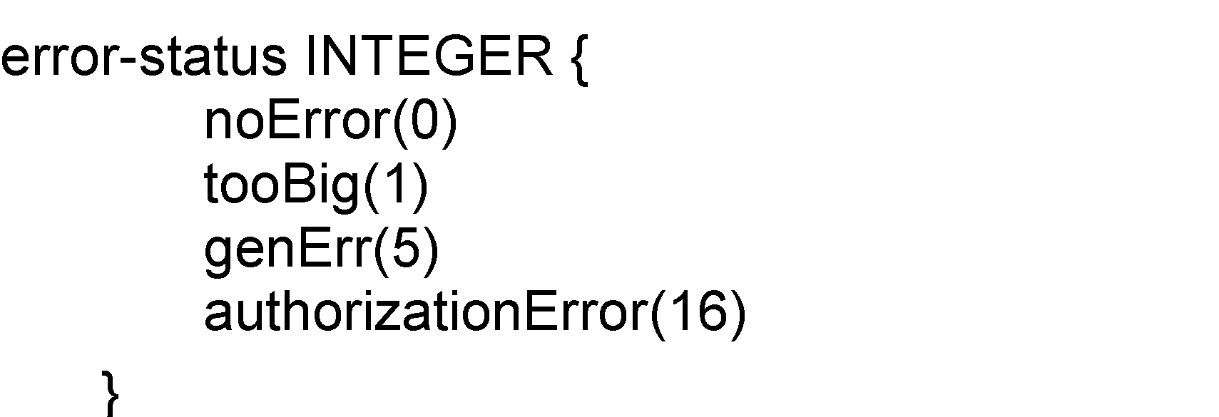
Chapter 4 SNMPv1 Network Management: Organization and Information Models
Enumerated
Special case of INTEGER data type
Notes
noError NULL by convention
Network Management: Principles and Practice
© Mani Subramanian 2010
*

Slide 34
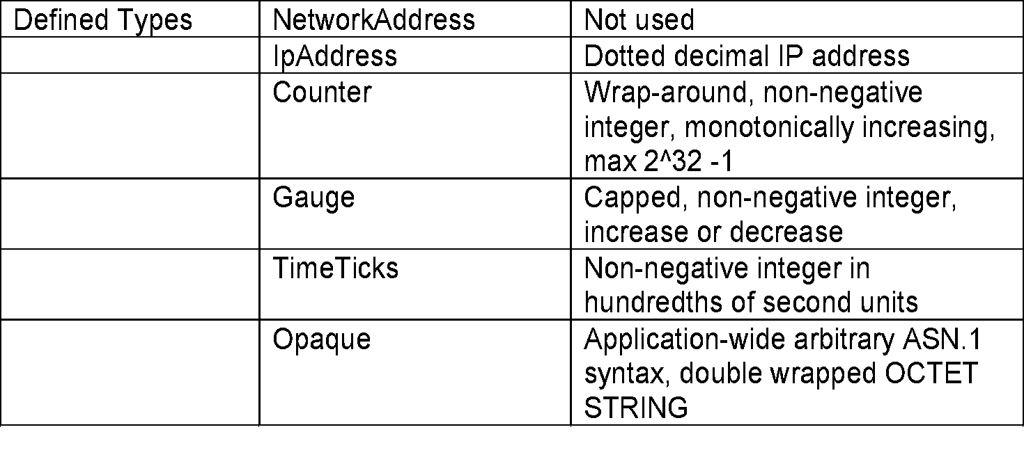
Chapter 4 SNMPv1 Network Management: Organization and Information Models
Defined or Application Data Type
Notes
Defined data types are simple or base types
Opaque is used to create data types based on previously defined data types
IpAddress is the conventional four groups of dotted decimal notation of IPv4
Counter is an application-wide data type and is a non-negative integer.
The data type Gauge is also a non-negative integer, but its value can move either up or down
TimeTicks is a non-negative integer and measures time in units of hundredths of a second.
Opaque is an application-wide data type that supports the capability to pass arbitrary ASN. 1 syntax. It is used to create more data types based on previously defined data types.

Slide 35
Chapter 4 SNMPv1 Network Management: Organization and Information Models
Constructor or Structured Data Type:
SEQUENCE
List maker
Notes
The third and last type of structure shown in Figure 4.15 is constructor or structured type. SEQUENCE and SEQUENCE OF are the only two constructor data types in Table 4. 1 that are not base types. They are used to build lists and tables.

Slide 36
Chapter 4 SNMPv1 Network Management: Organization and Information Models
Constructor or Structured Data Type:
SEQUENCE OF
Notes
Network Management: Principles and Practice
© Mani Subramanian 2010
*

Slide 37
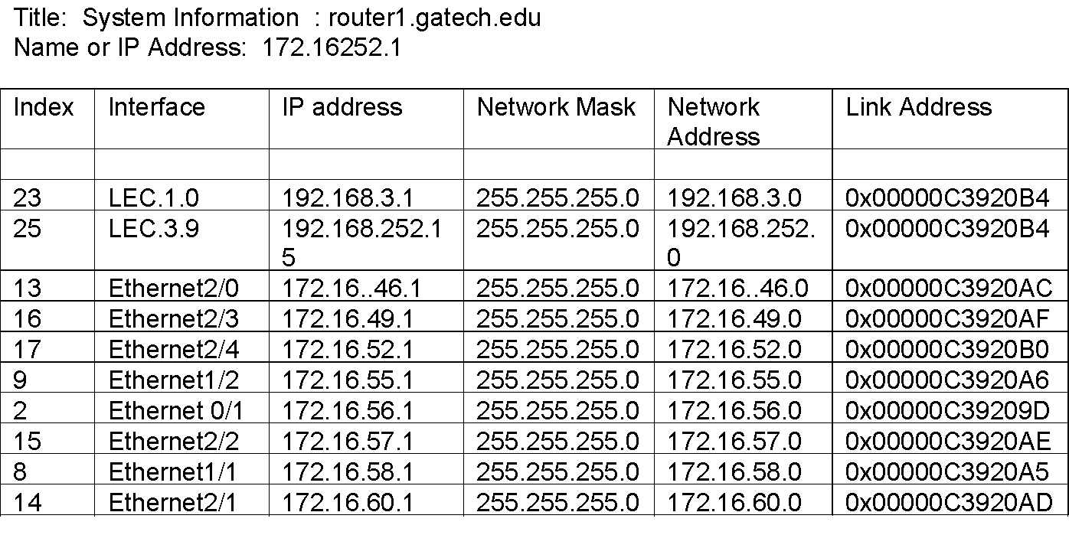
Chapter 4 SNMPv1 Network Management: Organization and Information Models
SEQUENCE OF Example
Notes
The above example (Figure 4.3) uses part of the IP MIB discussed for SEQUENCE OF construct.
Network Management: Principles and Practice
© Mani Subramanian 2010
*

Slide 38
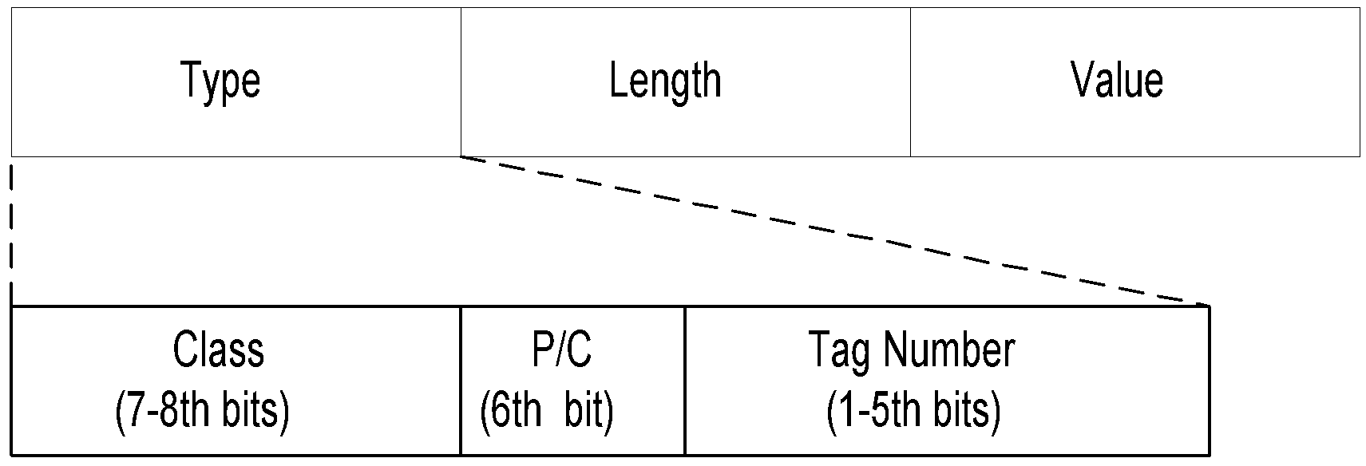
Chapter 4 SNMPv1 Network Management: Organization and Information Models
Encoding
Basic Encoding Rules (BER)
Tag, Length, and Value (TLV)
SNMP Data Types and Tags
Type Tag
OBJECT IDENTIFIER UNIVERSAL 6
SEQUENCE UNIVERSAL 16
IpAddress APPLICATION 0
Counter APPLICATION 1
Gauge APPLICATION 2
TimeTicks APPLICATION 3
Opaque APPLICATION 4
Encoding. SNMPvl has adopted BER with its TLV for encoding information to be transmitted between agent and manager processes.

Slide 39
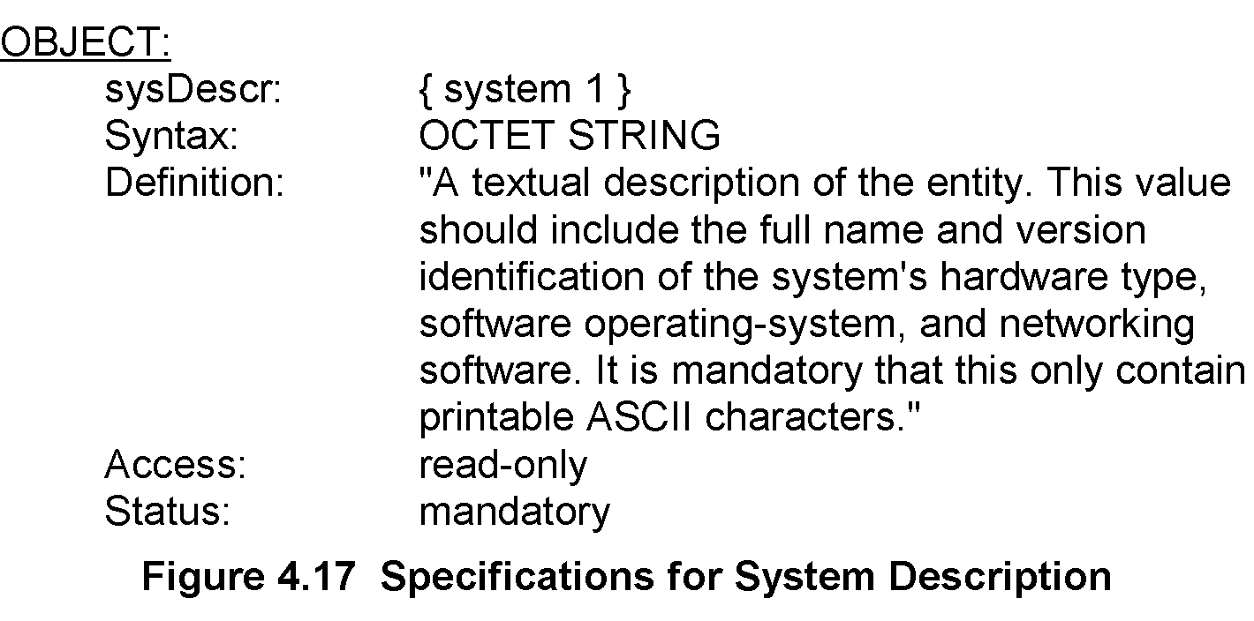
Chapter 4 SNMPv1 Network Management: Organization and Information Models
Managed Object: Structure
We will now specify in detail the SNMP data type format that would serve the basis for defining managed objects.
Structure of Managed Objects. Managed object has five parameters. They are textual name, syntax, definition, access, and status. For example, sysDescr is a data type in the MIB that describes a system. Specifications for the object that describes a system arc given in Figure 4.17.
the textual name for an object type is mnemonic and is defined as OBJECT DESCRIPTOR. It is unique and is made up of a printable string beginning with a lowercase letter, sysDescr, in our example.
Syntax is the ASN. 1 definition of the object type. The syntax of sysDescr is OCTET STRING.
A definition is an accepted textual description of the object type. It is a basis for the common language or semantics to be used by all vendors.
Access is the specification for the privilege associated with accessing the information. It is one of read-only, read-write, write-only, or not-accessible.
Status specifies whether the managed object is current or obsolete.

Slide 40
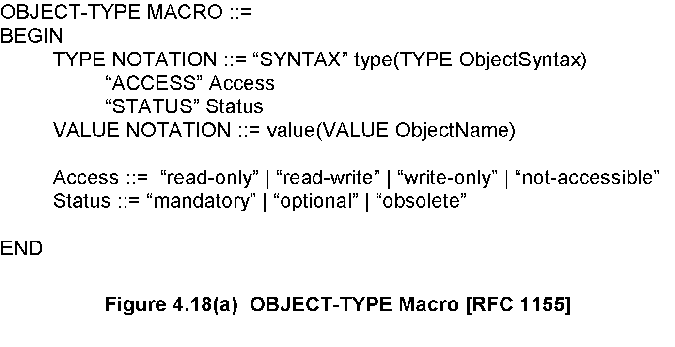
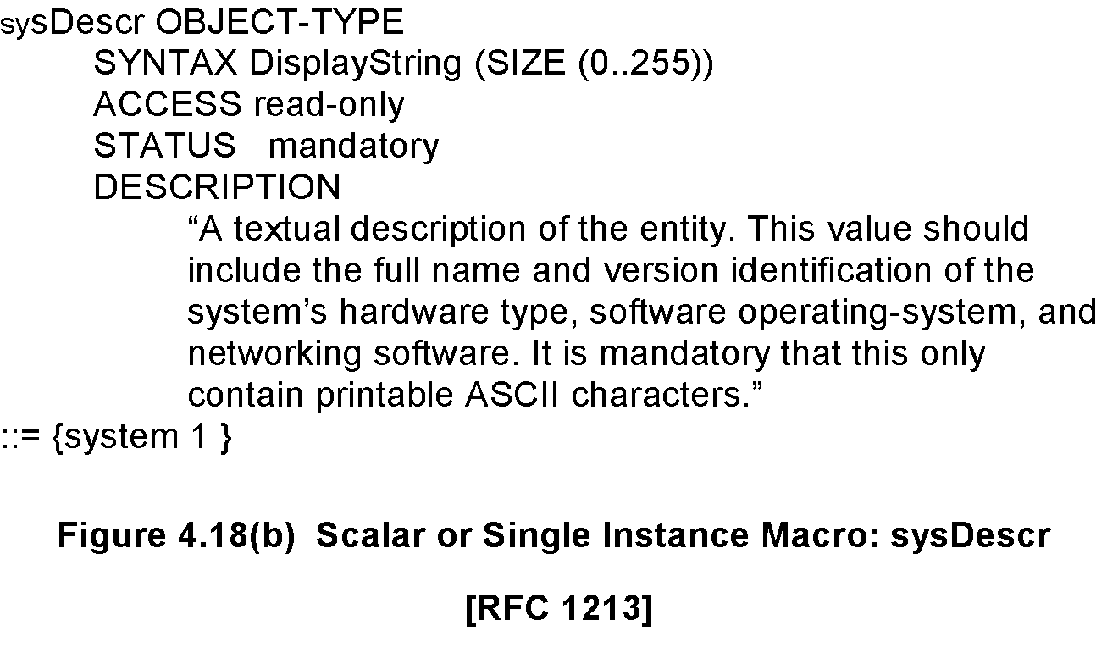
Chapter 4 SNMPv1 Network Management: Organization and Information Models
Managed Object: Macro
Macros for Managed Objects. In order to encode the above information on a managed object to be processed by machines, it has to be defined in a formalized manner. This is done using macros.
The body of the macro module consists of three parts: type notation, value notation, and supporting productions. TYPE NOTATION defines the data types in the module and VALUE NOTATION defines the name of the object. Thus, in the example of Figure 4.18, the notations SYNTAX, ACCESS, and STATUS define the data types Object Syntax, Access, and Status. The notation for value specifies the Object Name. Supporting productions in Figure 4.18 define the allowed values for access and status. Access can only be one of any of the four options: read-only, read-write, write-only, or not-accessible. Allowed values for Status are mandatory, optional, or obsolete.

Slide 41
Chapter 4 SNMPv1 Network Management: Organization and Information Models
Aggregate Object
A group of related objects
Also called tabular objects
Can be represented by a table with
Columns of objects
Rows of instances
Table of Objects
List of Objects
Objects
Notes
Example: IP address table
Consists of objects:
IP address
Interface
Subnet mask (which subnet this address belongs to)
Broadcast address (value of l.s.b. in IP broadcast address)
Largest IP datagram that can be assembled
Multiple instances of these objects associated with the node

Slide 42
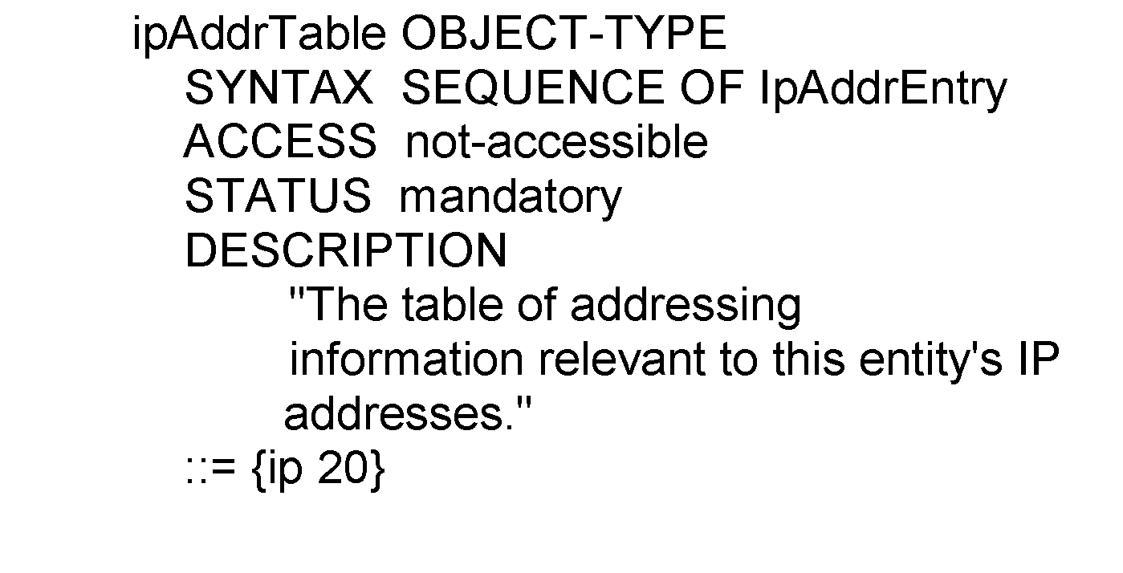
Chapter 4 SNMPv1 Network Management: Organization and Information Models
Aggregate M.O. Macro:
Table Object
ipAddrTable OBJECT-TYPE ::= {ip 20}
ipAddrEntry OBJECT-TYPE
::= {ipAddrTable 1}
Network Management: Principles and Practice
© Mani Subramanian 2010
*

Slide 43
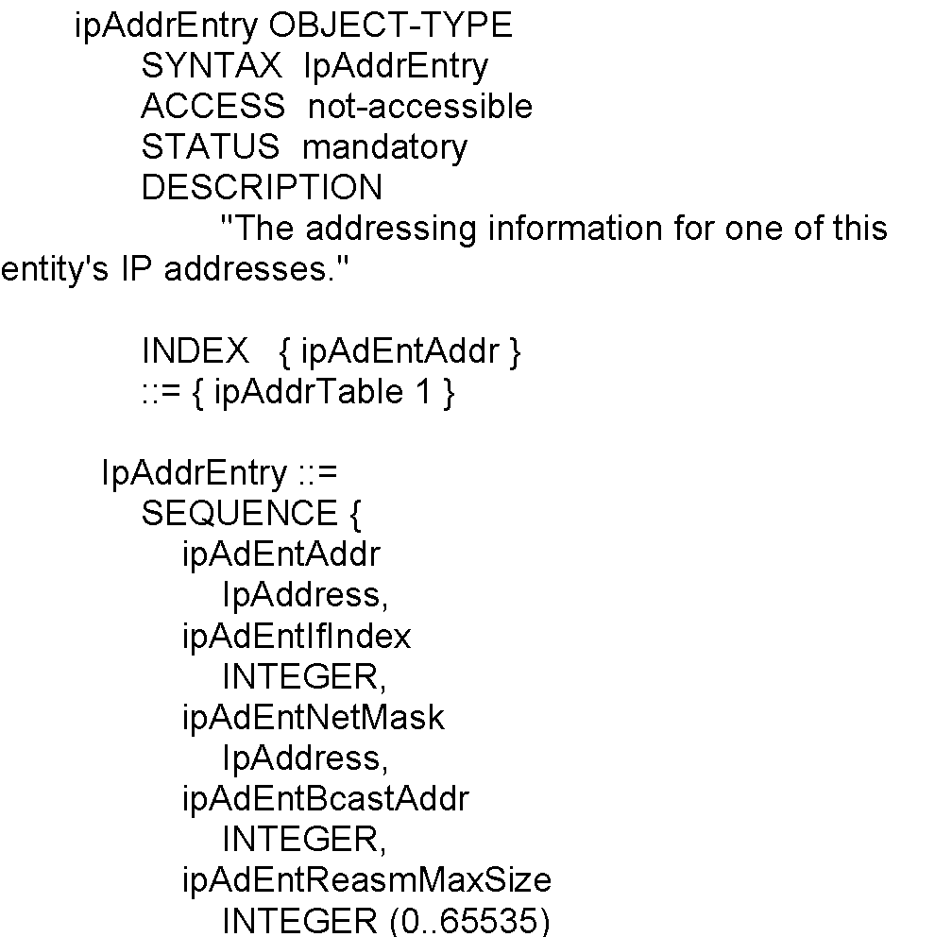
Chapter 4 SNMPv1 Network Management: Organization and Information Models
Aggregate M.O. Macro:
Entry Object
Notes
Index ipAdEntAddr uniquely identifies an instance
May require more than one object in the instance to uniquely identify it
Network Management: Principles and Practice
© Mani Subramanian 2010
*

Slide 44
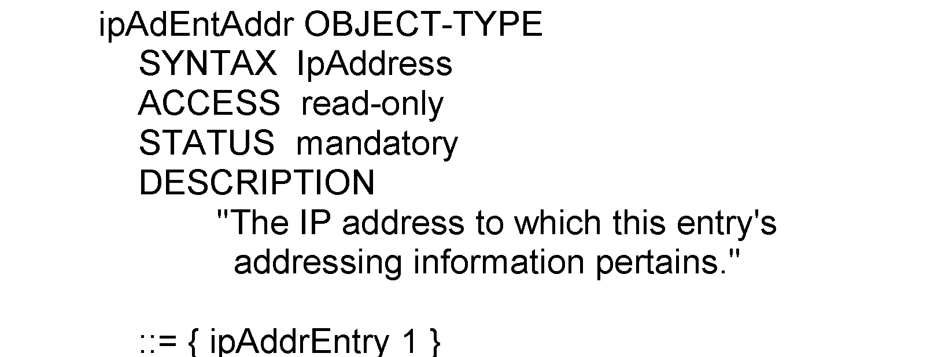
Chapter 4 SNMPv1 Network Management: Organization and Information Models
Aggregate M.O. Macro:
Columnar Objects
Notes
The REFERENCE clause is a textual reference to the document from which the object is being mapped. The INDEX clause is the columnar object identifier. DEFVAL is the default value to the object, if applicable.
Network Management: Principles and Practice
© Mani Subramanian 2010
*

Slide 45
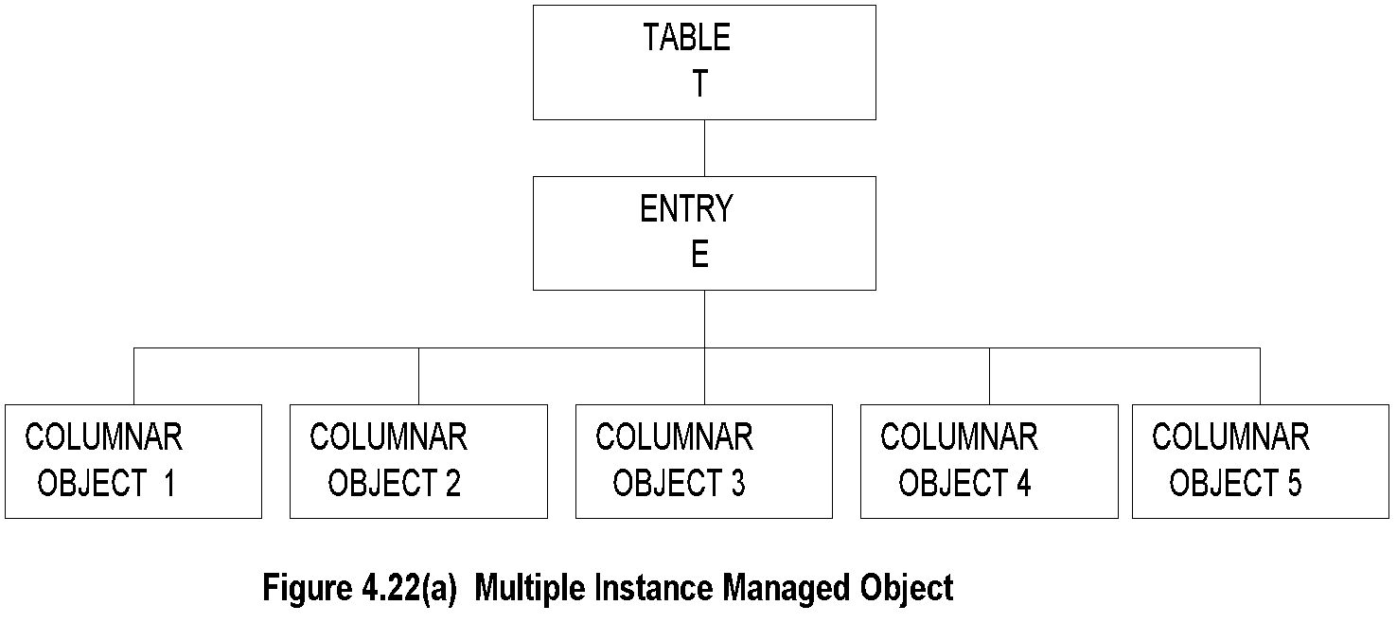
Chapter 4 SNMPv1 Network Management: Organization and Information Models
Tabular Representation of
Aggregate Object
Notes
The objects TABLE T and ENTRY E are objects that are logical objects. They define the grouping and are not accessible.
Columnar objects are objects that represent the attributes and hence are accessible.
Each instance of E is a row of columnar objects 1 through 5.
Multiple instances of E are represented by multiple rows.
Network Management: Principles and Practice
© Mani Subramanian 2010
*

Slide 46
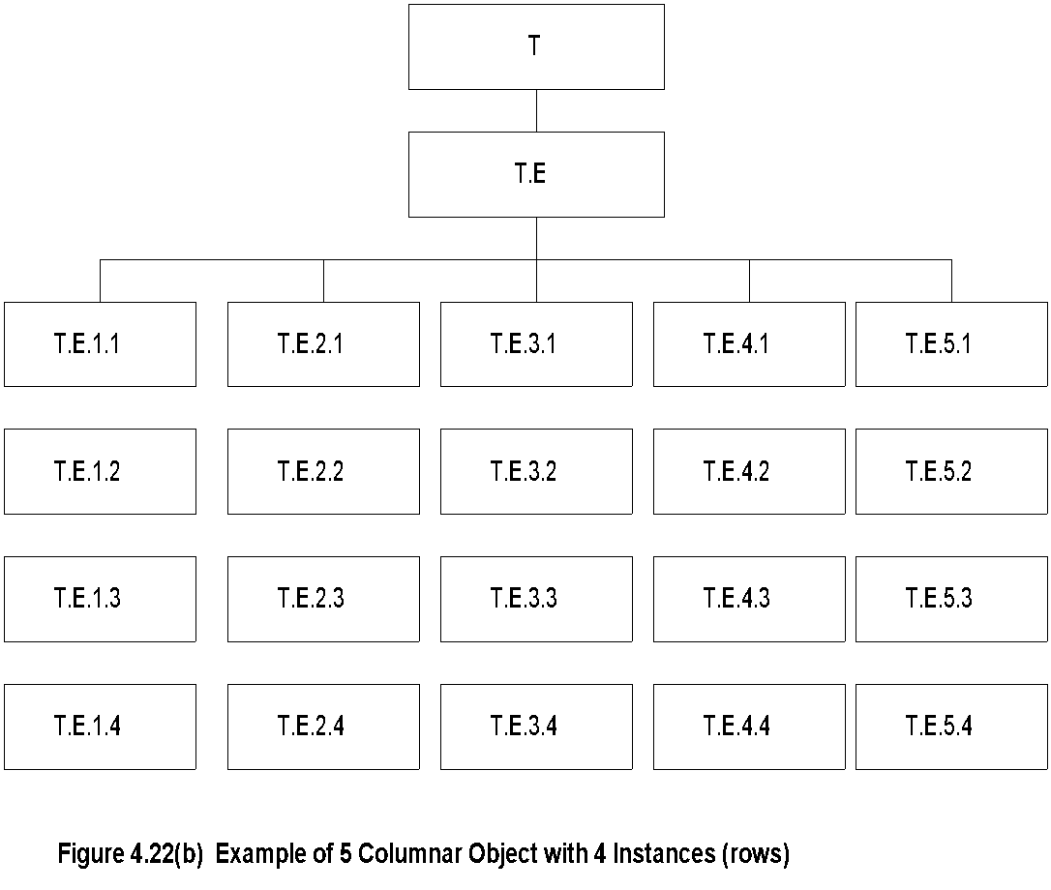
Chapter 4 SNMPv1 Network Management: Organization and Information Models
Tabular Representation of
Aggregate Object (cont.)
Notes
Notice that the column-row numeric designation is reverse of what we are used to as row-column
Figure 4.22(b) shows a five-columnar object with four instances, i.e., four rows. It is important to note the convention used in denoting each object in the rows. The columnar objects in each row are denoted by the concatenation of the object identifier of the table, the entry, and then the object, and lastly by the row number.
Network Management: Principles and Practice
© Mani Subramanian 2010
*

Slide 47
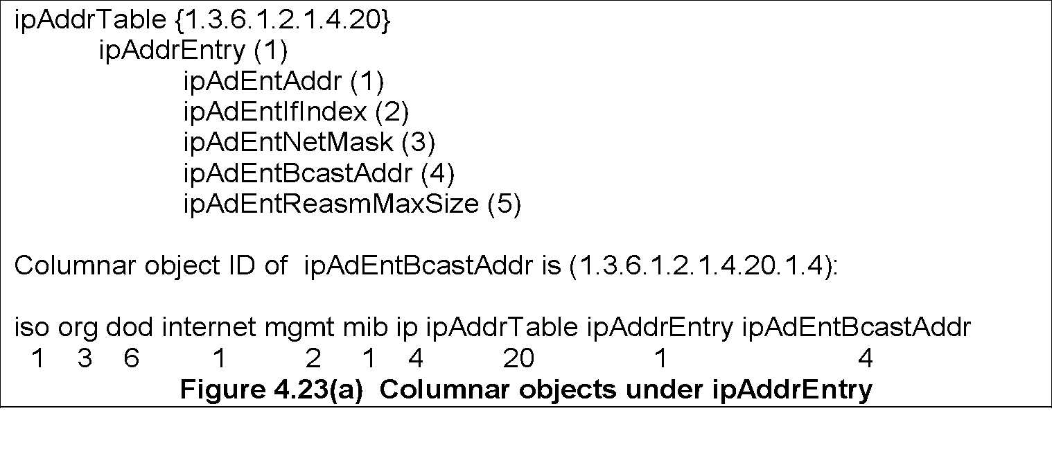
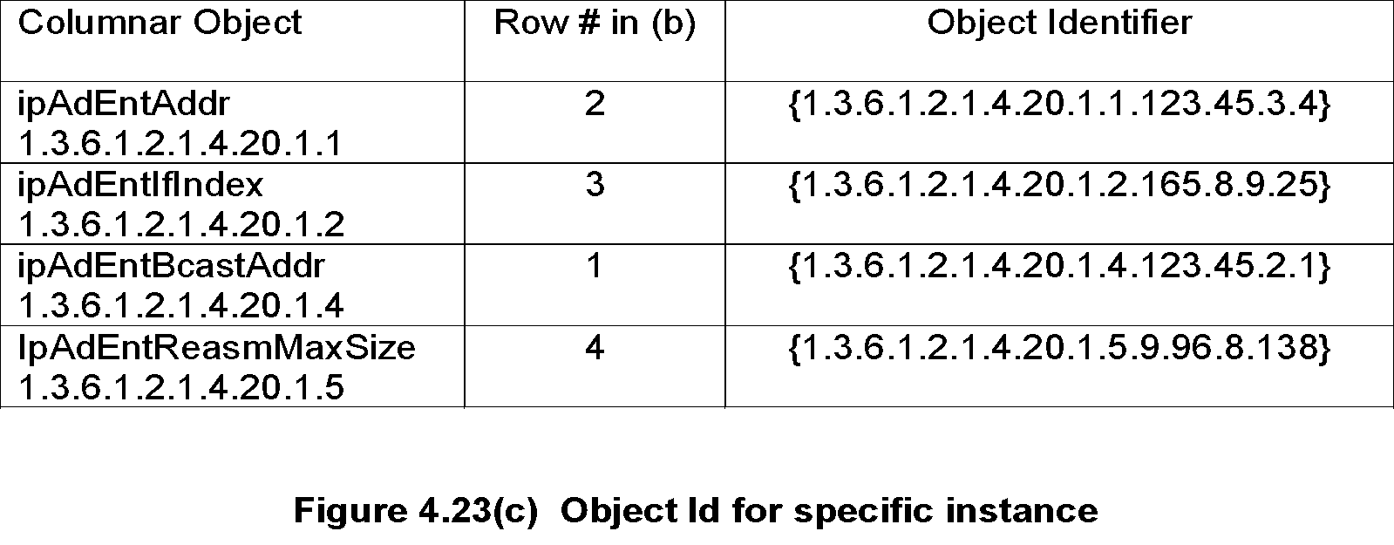
Chapter 4 SNMPv1 Network Management: Organization and Information Models
Multiple Instances of
Aggregate Managed Object
Figure 4.23(b) shows the tabular presentation of an IP address table. The table shows four rows and
six columns. Each of the four rows in the IP address table indicates a set of values associated with each
instance of ifAddrEntry in the table.
Figure 4.23(c) shows the representation of the object identifier associated with each instance.

Slide 48
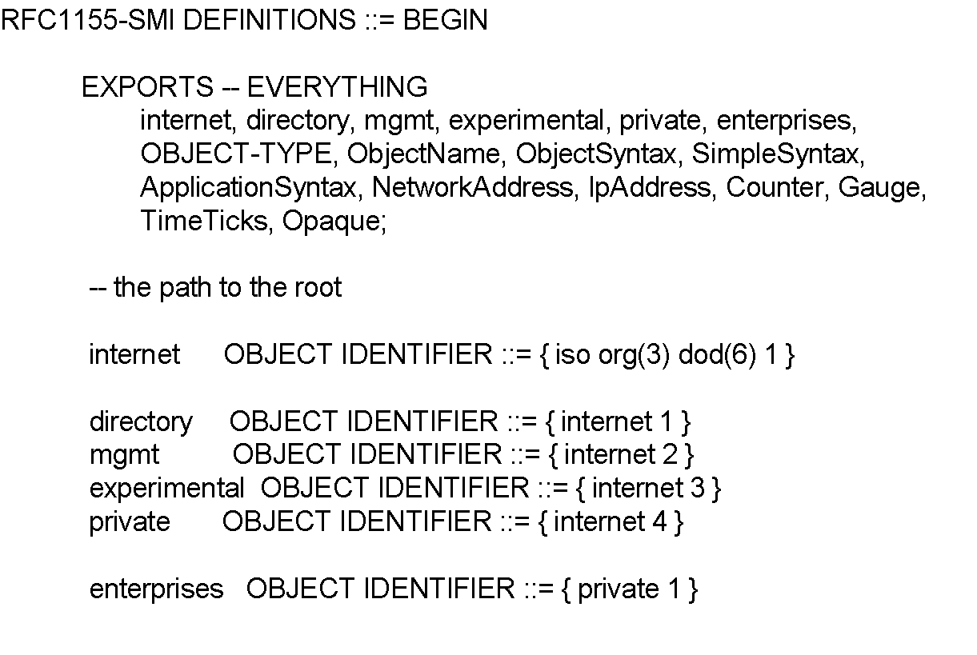
Chapter 4 SNMPv1 Network Management: Organization and Information Models
SMI Definition STD 16 / 1155 RFC
Notes
EXPORTS identifies the objects that any other module could import.
Network Management: Principles and Practice
© Mani Subramanian 2010
*

Slide 49
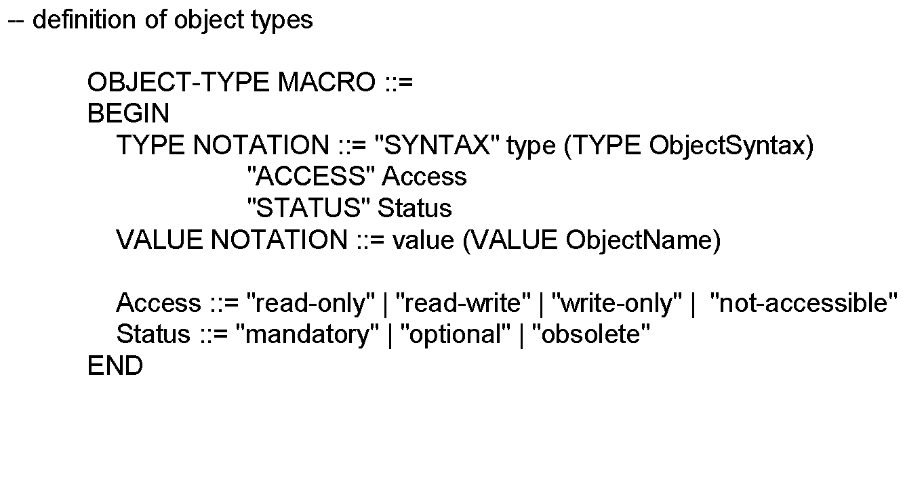
Chapter 4 SNMPv1 Network Management: Organization and Information Models
SMI Definition STD 16 / 1155 RFC (cont.)
Notes
Network Management: Principles and Practice
© Mani Subramanian 2010
*

Slide 50
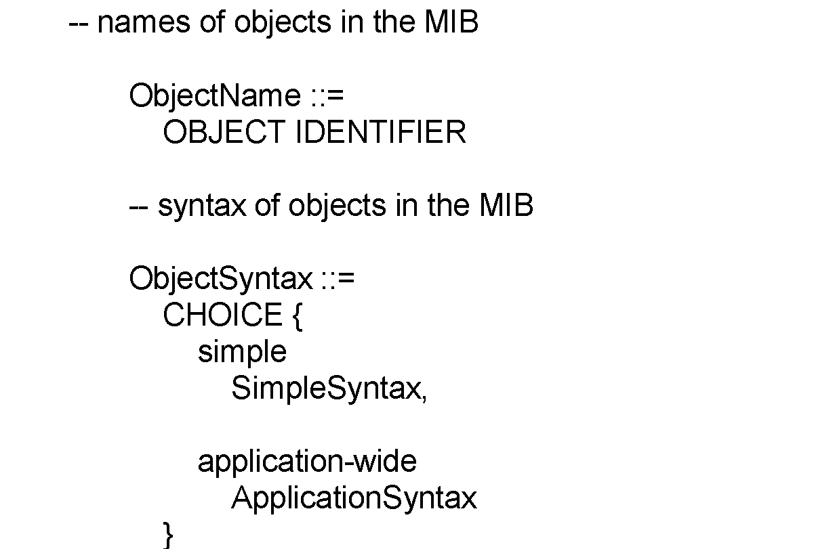
Chapter 4 SNMPv1 Network Management: Organization and Information Models
SMI Definition STD 16 / 1155 RFC (cont.)
Notes
Network Management: Principles and Practice
© Mani Subramanian 2010
*

Slide 51
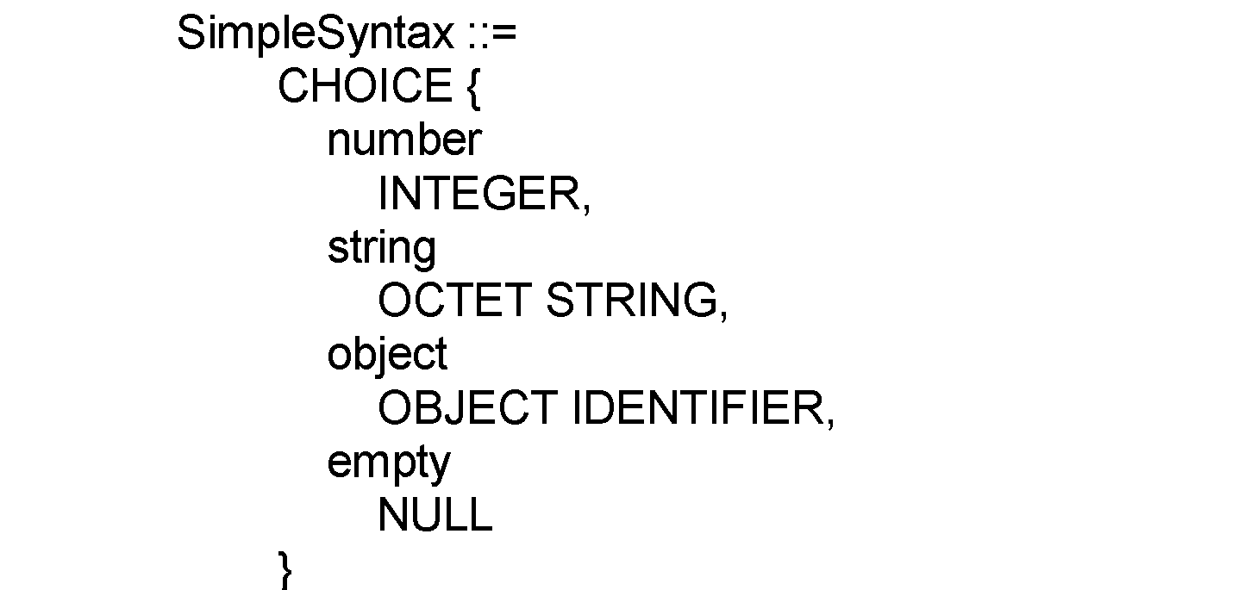
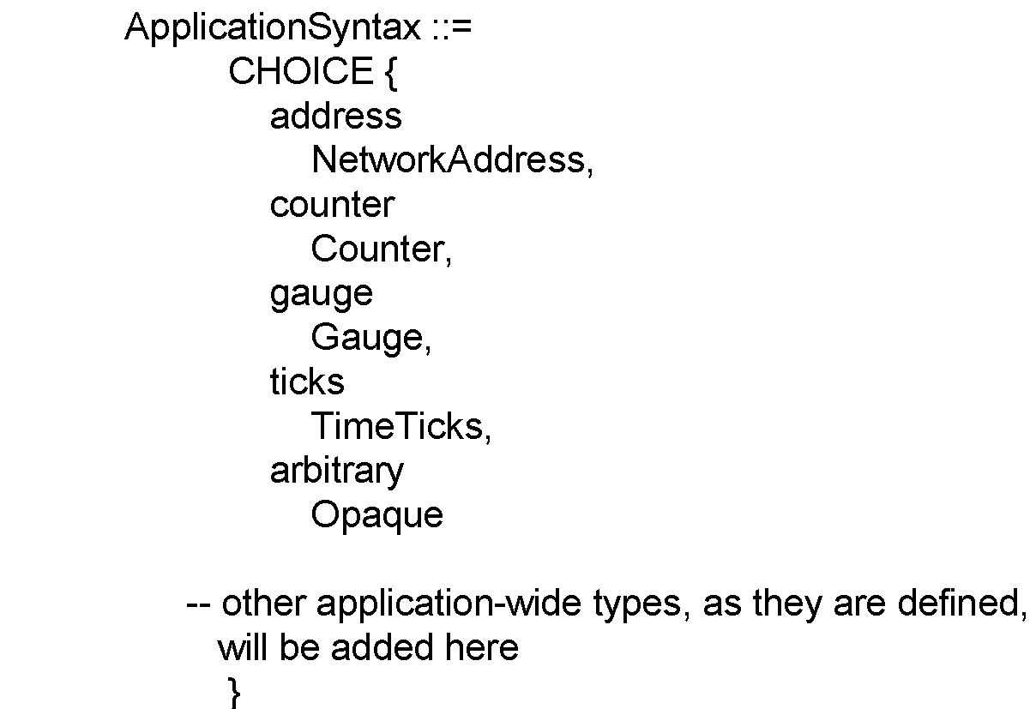
Chapter 4 SNMPv1 Network Management: Organization and Information Models
SMI Definition STD 16 / 1155 RFC (cont.)
Network Management: Principles and Practice
© Mani Subramanian 2010
*

Slide 52
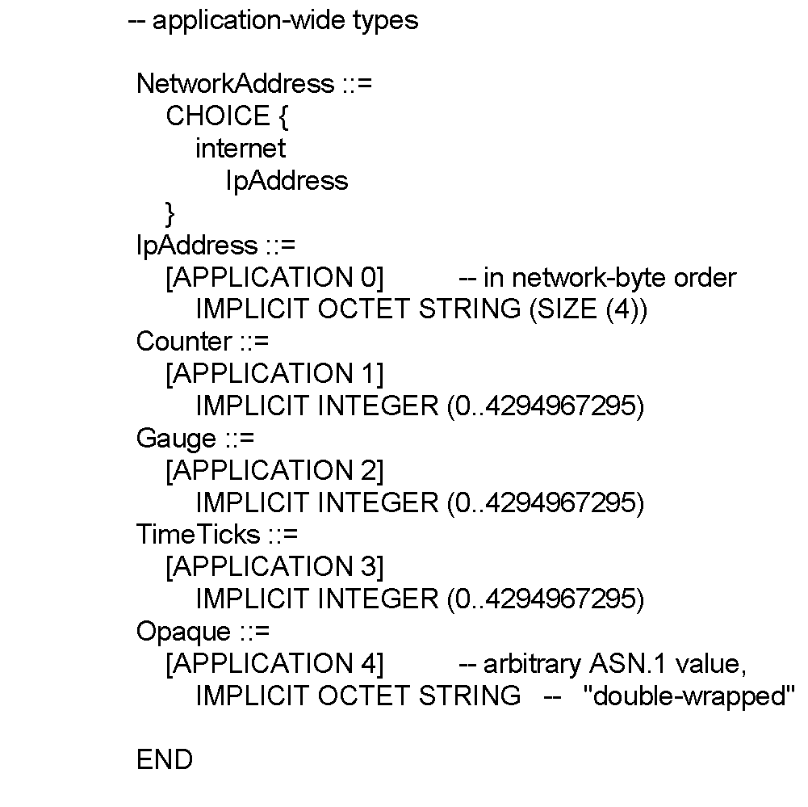
Chapter 4 SNMPv1 Network Management: Organization and Information Models
SMI Definition STD 16 / 1155 RFC (cont.)
Notes
Network Management: Principles and Practice
© Mani Subramanian 2010
*

Slide 53
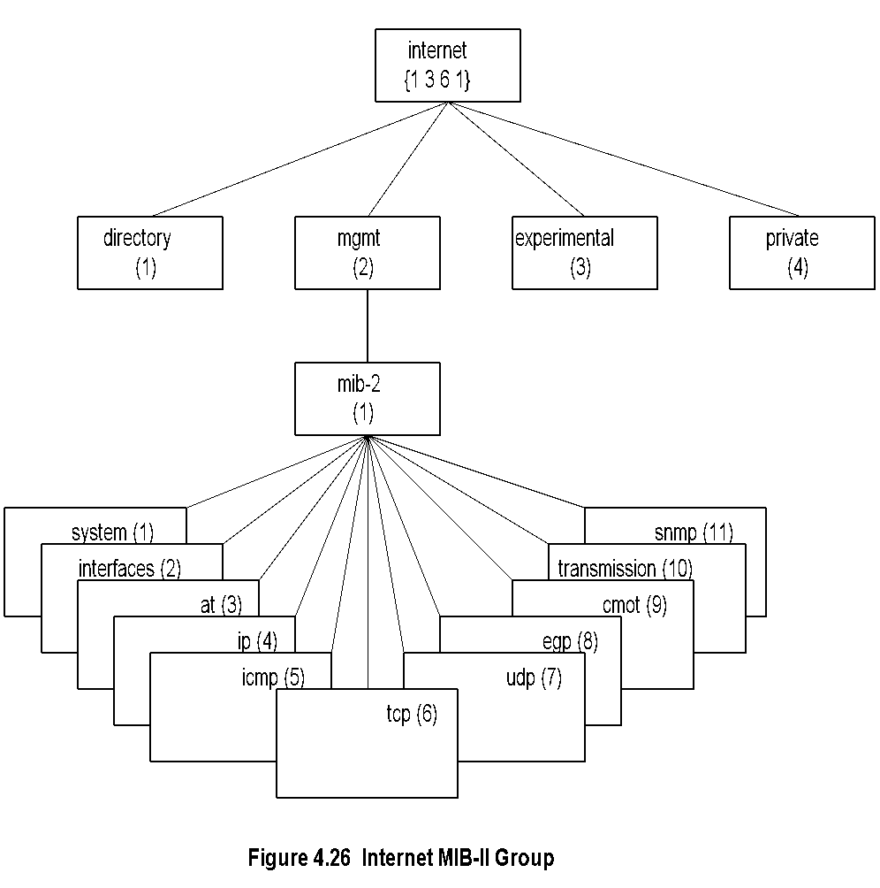
Management of Information Base
MIB
The entire MIB does not have to be implemented in either the manager or the agent process.
MIB is a virtual information store (base).
Managed objects are accessed via this virtual information base. Objects in the MIB are defined using ASN.l
Notes
MIB-II (RFC 1213) is superset of MIB-I.
Objects that are related grouped into object groups.
MIB module comprises module name, imports from other modules, and definitions of current module.
RFC 1213 defines eleven groups; expanded later.
*

Slide 54
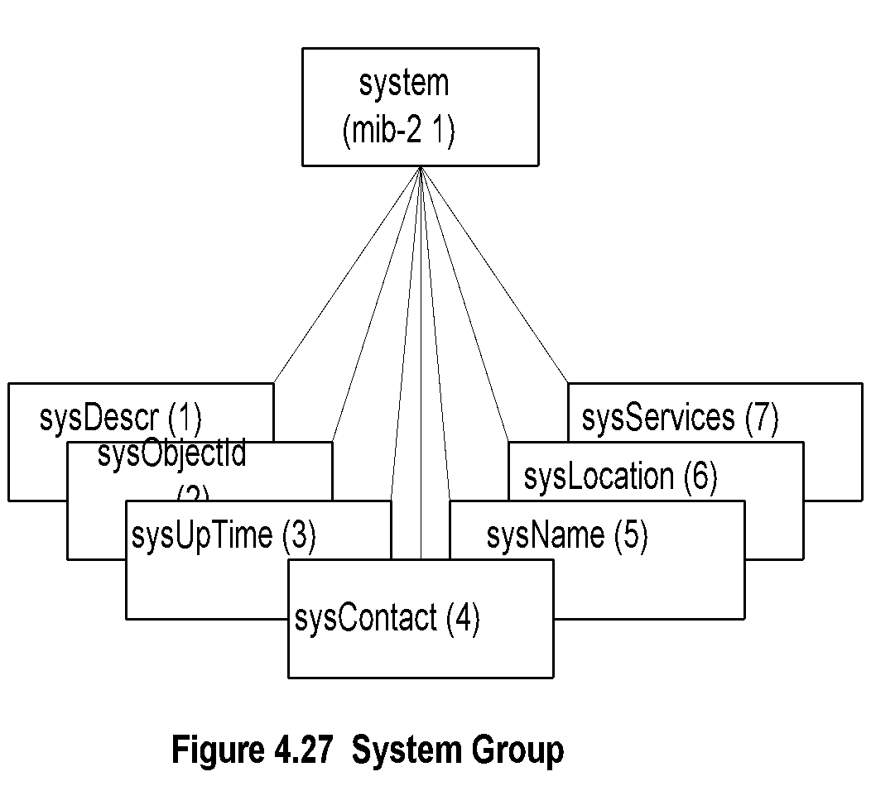
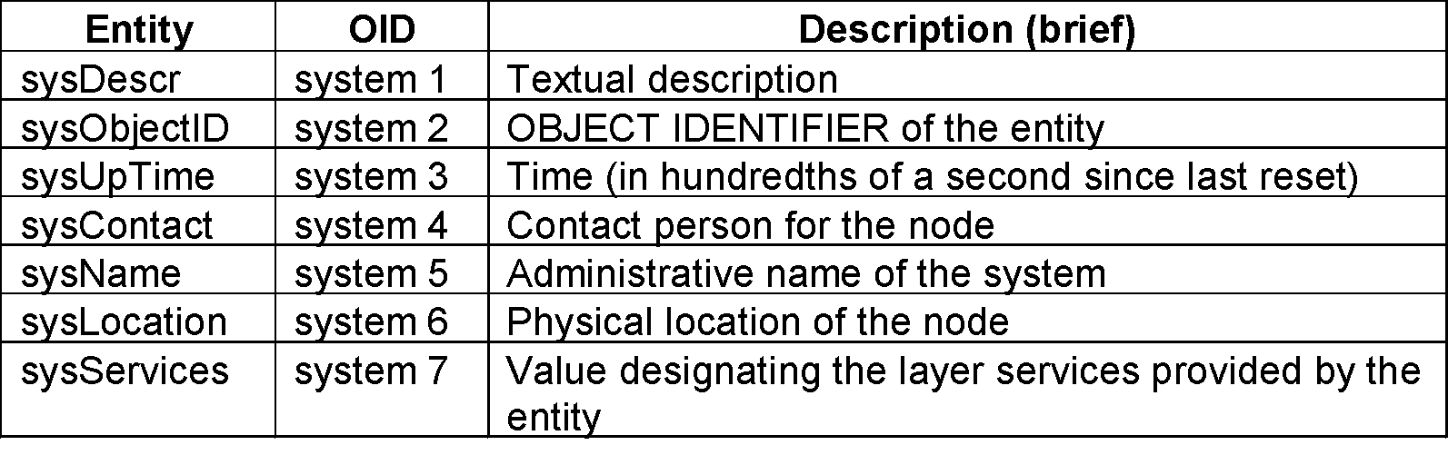
Chapter 4 SNMPv1 Network Management: Organization and Information Models
System Group
Object Groups. Objects that are related are grouped into object groups. Notice that this grouping is different from the grouping of object types to construct an aggregate object type. Object groups facilitate logical assignment of object identifiers. One of the criteria for choosing objects to be included in standards is that it is essential for either fault or configuration management. Thus, if a group is implemented in a system by a vendor, all the components are implemented, i.e., status is mandatory for all its components. For example, if the External Gateway Protocol (EGP) is implemented in a system, then all EGP group objects are mandatory to be present.
The System group contains objects describing system administration. The Interfaces group defines interfaces of the network component and network parameters associated with each of those interfaces. The Address translation group is a cross-reference table between the IP address and the physical address. IP,ICMP,TCP, UDP, and EGP groups are the grouping of objects associated with the respective protocol of the system.
Notes
System Group. The System group is the basic group in the Internet standard MIB. Its elements are probably the most accessed managed objects. After an NMS discovers all the components in a network or newly added components in the network, it has to obtain information on the system it discovered, such as system name, object ID, etc
Implementation of the System group is mandatory for all systems in both the agent and the manager. It consists of seven entities, which are presented in Figure 4.27 and Table 4.5.

Slide 55
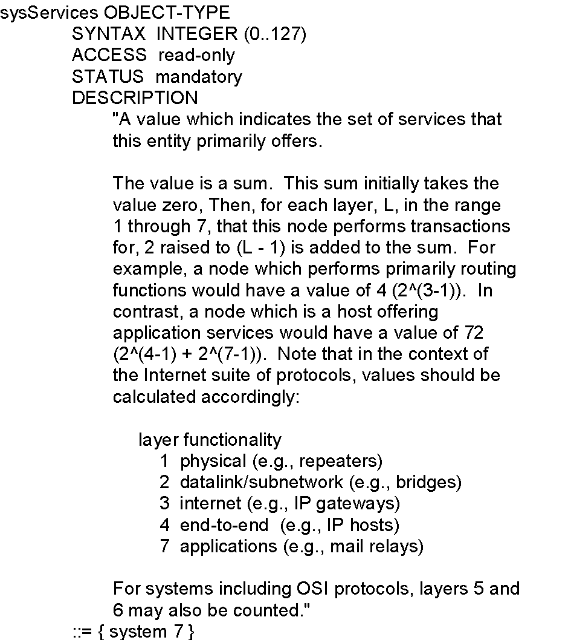
Chapter 4 SNMPv1 Network Management: Organization and Information Models
sysServices
Notes
Network Management: Principles and Practice
© Mani Subramanian 2010
*

Slide 56
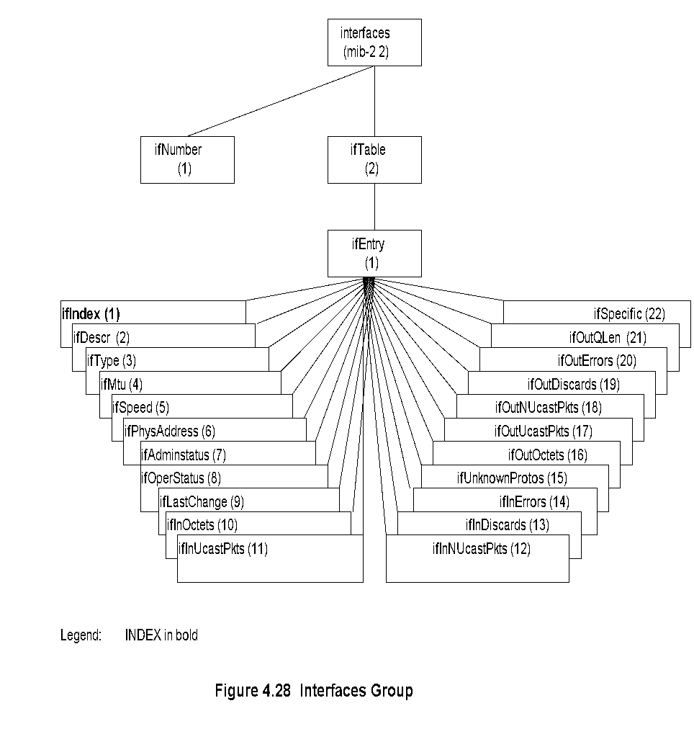
Chapter 4 SNMPv1 Network Management: Organization and Information Models
Interfaces Group
Interfaces Group. The Interfaces group contains managed objects associated with the interfaces of a system. If there is more than one interface in the system, the group describes the parameters associated with each interface. For example, if an Ethernet bridge has several network interface cards, the group would cover information associated with each interface. However, the Interfaces MIB contains only generic parameters. In the Ethernet example, there is more information associated with the Ethernet LAN, which is addressed in the MIB specifications of the particular medium, as in Definitions of Managed Objects for the Ethernet-like Interface types [RFC 2358], An NMS would combine information obtained from various groups in presenting comprehensive data to the user. The Interfaces group specifies the number of interfaces in a network component and managed objects associated with each interface. Implementation of Interfaces group is mandatory for all systems. It consists of two nodes as shown in Figure 4.28 and Table 4.6.

Slide 57
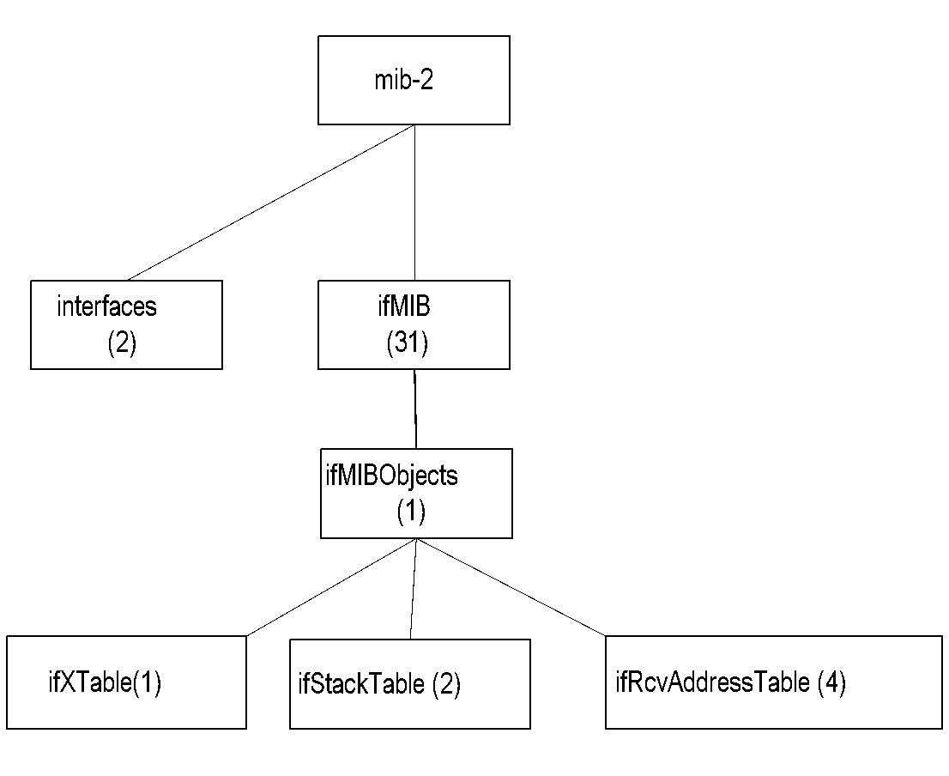
Chapter 4 SNMPv1 Network Management: Organization and Information Models
Extension to Interfaces MIB
Notes
Interfaces MIB limited by maximum number of physical ports
A physical port may have several conceptual ports e.g., channels in cable access network
ifMIB {mib-2 31} created to extend interfaces MIB
ifMIB speicifies extension in generic manner
Specific technology related MIBs supplement details on the conceptual ports
ifIndex in interfaces MIB can exceed the maximum number of physical ports
ifStack definition accommodates interface sublayers
Network Management: Principles and Practice
© Mani Subramanian 2010
*

Slide 58
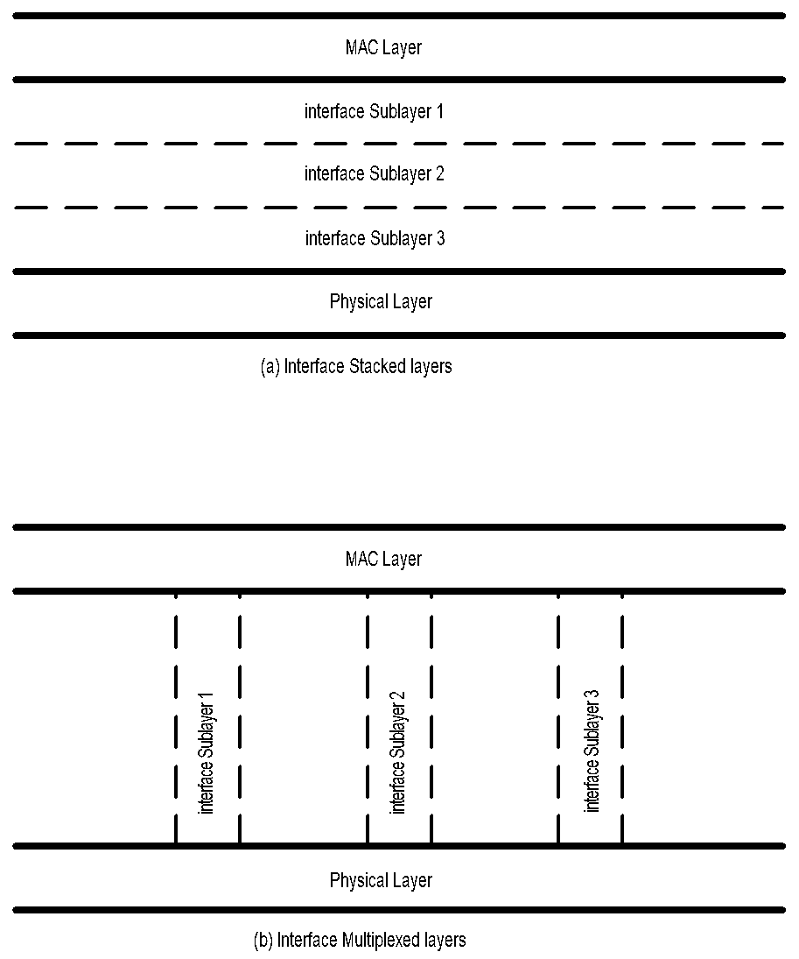
Chapter 4 SNMPv1 Network Management: Organization and Information Models
Interface Sublayers
Interface Sublayers. One of the strengths of an IP network layer protocol is that it is designed to run over any network interface. IP considers any and all protocols it runs over as a single "network interface“ layer.
The Interfaces group defines a generic set of managed objects such that any network interface can be managed in an interface-independent manner through these managed objects. The Interfaces group provides the means for additional managed objects specific to particular types of network interface (e.g., a specific medium such as Ethernet or Time Division Multiplex (TDM) channels) to be defined as extensions to the Interfaces group for media-specific management.
Figure 4.29 Interface Sublayers

Slide 59
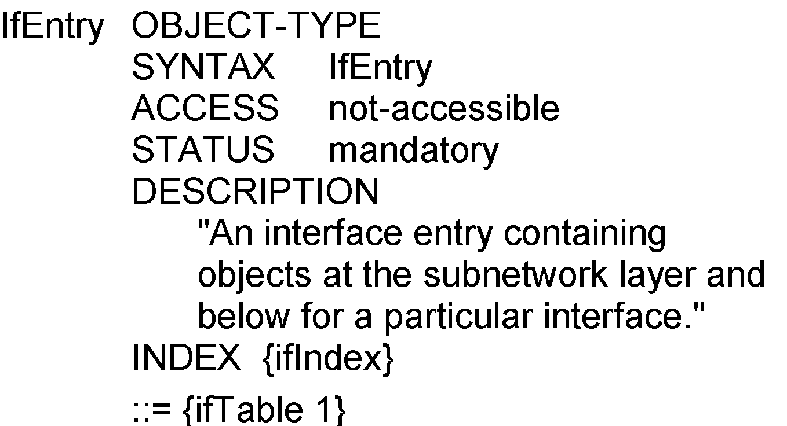
Chapter 4 SNMPv1 Network Management: Organization and Information Models
ifEntry
Notes
ifEntry specifies the objects in a row in the ifTable.
Each interface is defined as a row in the table.
Address Translation Group. The Address Translation group consists of a table that converts Network Address to a physical or subnetwork address for all interfaces of the system.
Network Management: Principles and Practice
© Mani Subramanian 2010
*

Slide 60
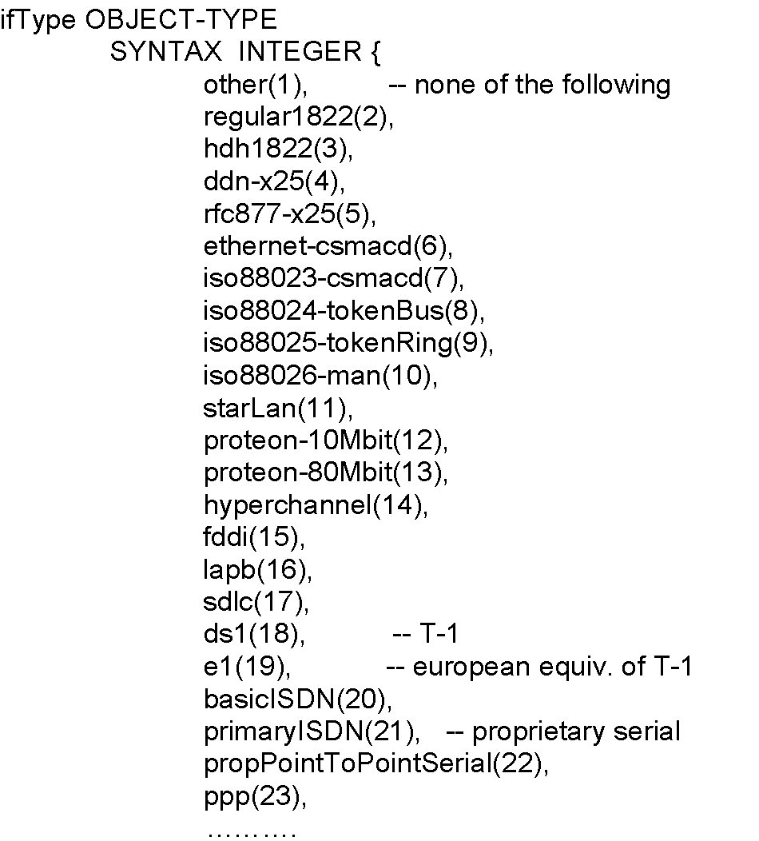
Chapter 4 SNMPv1 Network Management: Organization and Information Models
ifType
Notes
Type of interface below the network layer defined as enumerated integer.
Network Management: Principles and Practice
© Mani Subramanian 2010
*

Slide 61
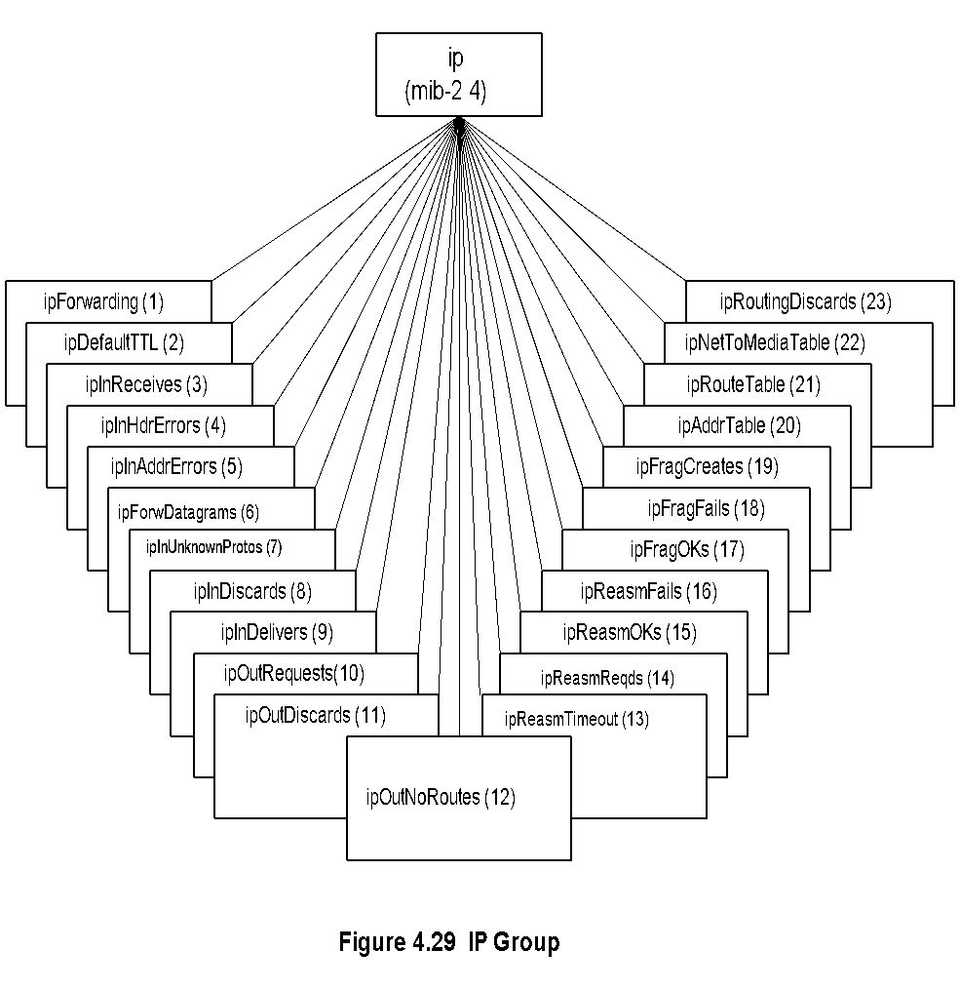
Chapter 4 SNMPv1 Network Management: Organization and Information Models
IP Group
IP Group. The Internet is based on IP protocol as the networking protocol. This group has information on various parameters of the protocol. It also has a table that replaces the Address Translation table. Routers in the network periodically execute the routing algorithm and update its routing table, which are defined as managed objects in this group. We will discuss the contents of this group in detail now.
The TP group defines all the parameters needed for the node to handle a network layer IP protocol either as a host or as a router; implementation is mandatory. Figure 4.31 and Table 4.7 present the tree structure and details of the entities, respectively. The group contains three tables, IP address table, IP routing table, and IP Address Translation table.
We can use the IPMIB to acquire any information associated with the IP layer. For example, to learn the value of the managed object, ip Forwarding will indicate whether the node is acting as just a router or a gateway between two autonomous networks. We can measure IP datagrams received that are in error, such as those with wrong addresses (ipInAddrErrors).
The three tables belonging to the IP group are shown in Figure 4.32 (IP Address Table), Figure 4.33 (IP Routing Table), and Figure 4.34 (IP Address Translation Table). Table 4.8 shows the entity table for the IP address table. The index for the table, ipAdEntAddr, is shown in bold letters. In Figure 4.23(b), we illustrated an example of four instantiations (rows) associated with the IP address table. The IP address table MIB shown in Figure 4.32 and Table 4.8 is used to retrieve data from the router. It could be retrieved using get-request or get-next-request commands.
Notes
ipForwarding: Gateway(1) and Router(2)
IP Address Table contains table of IP addresses
IP Route Table contains an entry for each route
IP Network-to-Media Table is address translation table mapping IP addresses to physical addresses

Slide 62
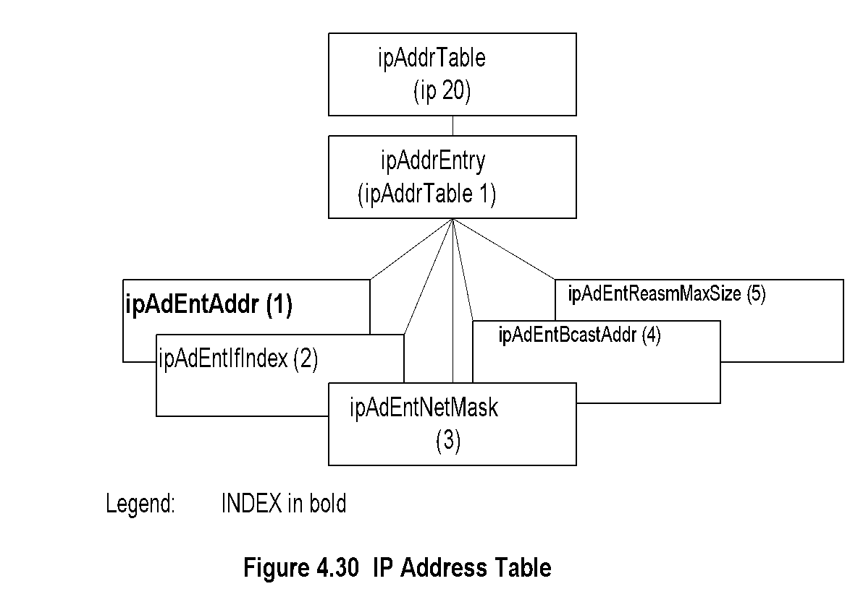
Chapter 4 SNMPv1 Network Management: Organization and Information Models
IP Address Table
Notes
Network Management: Principles and Practice
© Mani Subramanian 2010
*

Slide 63
Chapter 4 SNMPv1 Network Management: Organization and Information Models
IP Routing Table
Network Management: Principles and Practice
© Mani Subramanian 2010
*

Slide 64
Chapter 4 SNMPv1 Network Management: Organization and Information Models
IP Address Translation Table
Notes
Network Management: Principles and Practice
© Mani Subramanian 2010
*

Slide 65
Chapter 4 SNMPv1 Network Management: Organization and Information Models
ICMP Group
Notes
Objects associated with ping
icmpOutEchos # ICMP echo messages sent
icmpInEchoReps # ICMP echo reply messages received
Objects associated with traceroute/tracert
icmpInTimeExcs # ICMP time exceeded messages received
Network Management: Principles and Practice
© Mani Subramanian 2010
*

Slide 66
Chapter 4 SNMPv1 Network Management: Organization and Information Models
TCP Group
TCP Group. The transport layer of the Internet defines Transmission Control Protocol (TCP) for a connection-oriented circuit and User Datagram Protocol (UDP) for a connectionless circuit.
The TCP group contains entities that are associated with the connection-oriented TCP. They are present only as long as the particular connection persists. It is mandatory to implement this group. The entities are shown in Figure 4.37 and Table 4.13. It contains one table, the TCP connection table, which is presented in Figure 4.38 and Table 4.14. The table entry has four indices to uniquely define it in the table. They are: tcpConnLocalAddress, tcpConnLocalPort, tcpConnRemAddress, and tcpConnRemPort and are identified in boldface. One may obtain all TCP active sessions from this table with addresses and ports of local and remote entities.
Notes
Connection-oriented transport protocol group
Has one table
Network Management: Principles and Practice
© Mani Subramanian 2010
*

Slide 67
Chapter 4 SNMPv1 Network Management: Organization and Information Models
TCP Connection Table
Notes
Network Management: Principles and Practice
© Mani Subramanian 2010
*

Slide 68
Chapter 4 SNMPv1 Network Management: Organization and Information Models
UDP Group
Notes
Connectionless transport protocol group
Has one table, UDP table
Network Management: Principles and Practice
© Mani Subramanian 2010
*

Slide 69
Summary
The Internet Engineering Task Force is the standards organization and RFC, STD, and FYI are IETF documents on standards development.
SNMP management is organized as two-tier management, in which a manager process and an agent process communicate with each other. The agent process resides in the network element. The manager process is built in network management stations. The agent process does not perform any analysis, which is done in the manager. The two-tier structure can be extended to three-tier by sandwiching a proxy agent, or RMON, between the manager and the agent.
All management operations are done using five messages in SNMPvl , which is the current standard. They are get-request, get-next, set-request, get-response, and trap. The first three are sent from the manager to the agent, and the last two are sent by the agent to the manager.
Messages are exchanged according to specifications defined in the Structure of Management Information (SMI). It is composed of name, syntax, and encoding rules. The name is a unique name for the managed object and an associated unique object identifier. The syntax uses Abstract Syntax Notation 1 (ASN.1) language. Encoding is done using basic encoding rules (BER).
Objects or entities can be composed of other scalar objects. Multiple instances of a managed object, such as the IP address table, are handled by defining tables and columnar objects in the table. Managed objects are organized in a virtual database, called the Management Information Base (MIB). It is distinct from the management database that contains values for managed objects. Managed objects are grouped in the MIB according to their function. MIB-II, which is a superset of MIB-I, consists of 11 groups. Several groups have since been added to the MIB, although they have not been approved as a standard.

